Slide 1
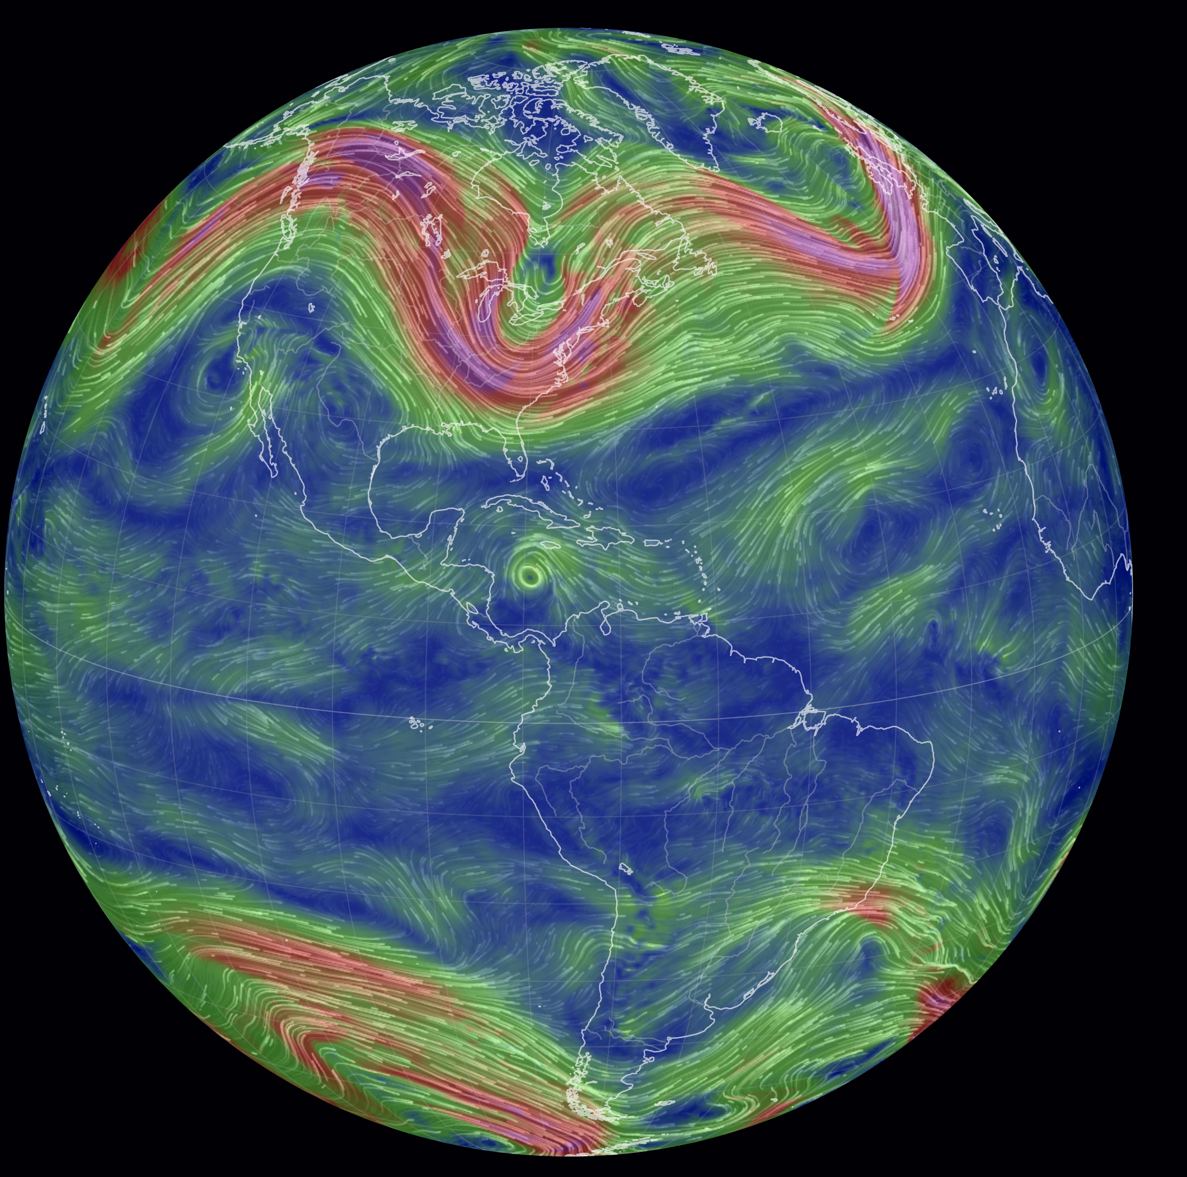
EES 3506 / 5506
Observing and Modeling Climate Change
Fall 2023
Lecture:
TR 9:30 – 10:50 AM, BEURY 304
Instructor:
Dr. Becki Beadling (she/hers)
rebecca.beadling@temple.edu
315A BEURY Hall
Office hours: Wednesday 1 – 3 pm

Slide 2
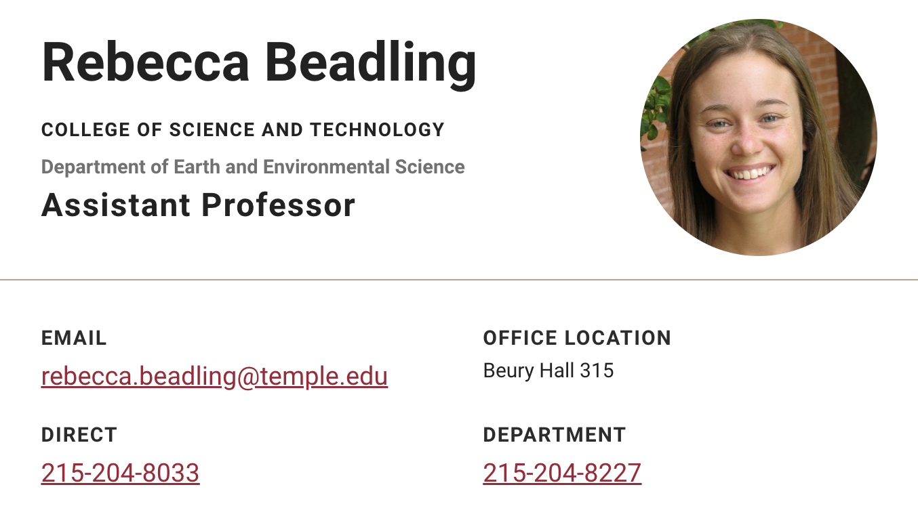
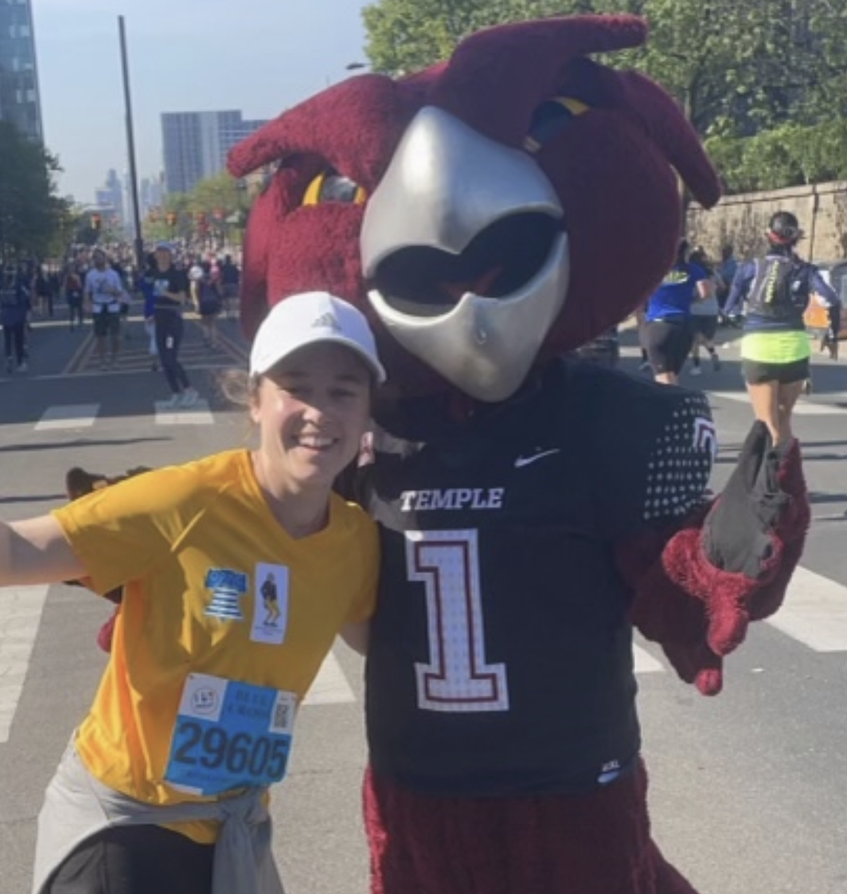
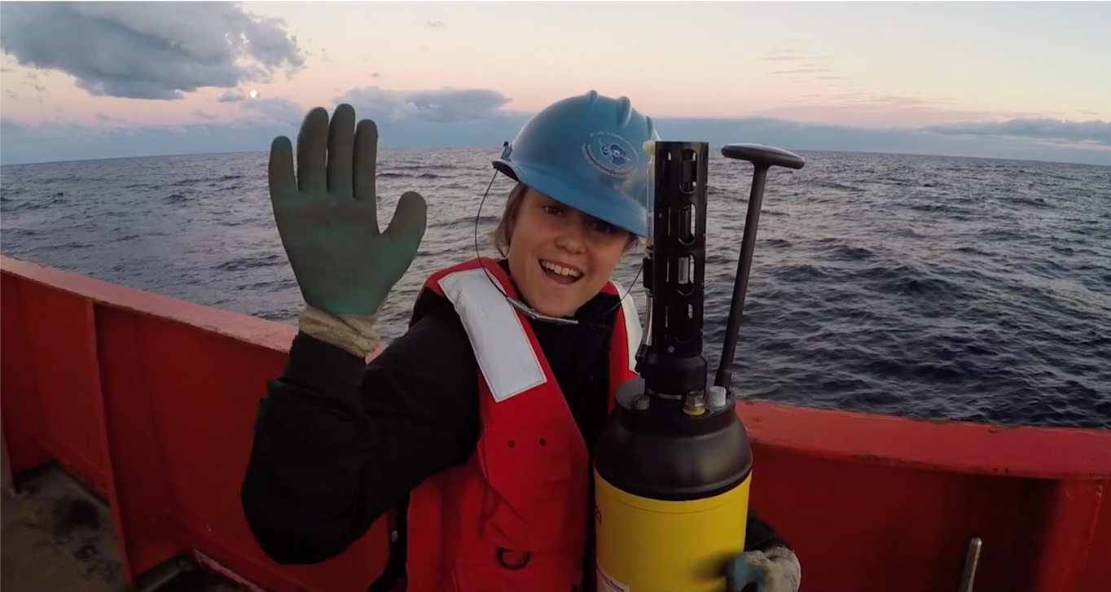
Who is Dr. Becki Beadling ???

Slide 3
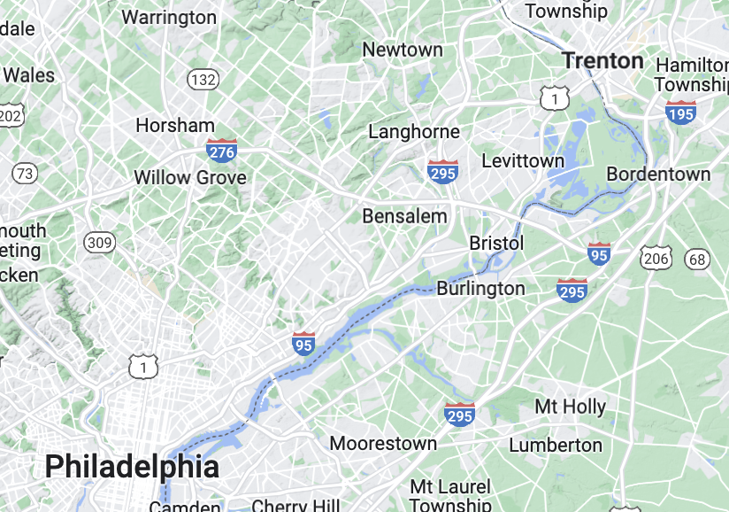

Who is Dr. Becki Beadling ???
24 miles

Slide 4
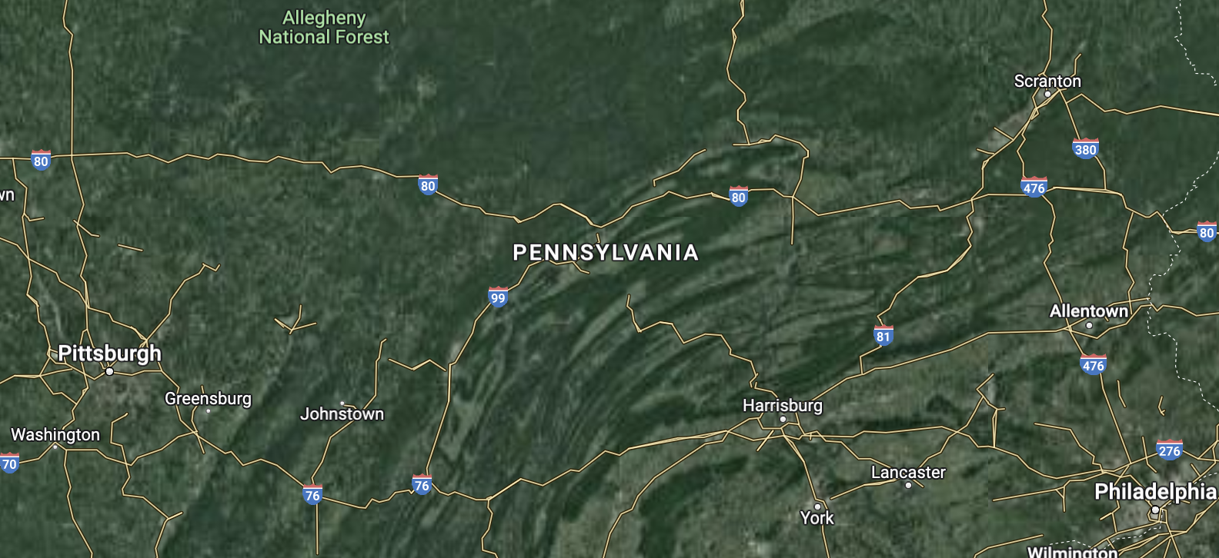




Who is Dr. Becki Beadling ???
24 miles
Indiana University of Pennsylvania (IUP)
B.A. Biology
B.S. Chemistry
Minor Mathematics

Slide 5
Who is Dr. Becki Beadling ???
B.S. Biology Education
Highschool Biology teacher

Slide 6
Who is Dr. Becki Beadling ???
B.S. Biology Education
Highschool Biology teacher
B.A. Biology
B.S. Chemistry
Minor Mathematics
Graduate School for Materials Science

Slide 7
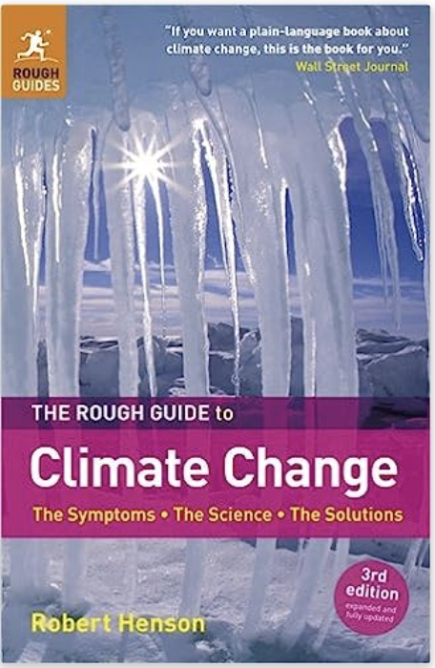


Who is Dr. Becki Beadling ???
B.S. Biology Education
Highschool Biology teacher
B.A. Biology
B.S. Chemistry
Minor Mathematics
Graduate School for Materials Science
How can I apply my knowledge and skill set to studying the climate system an climate change?

Slide 8
Who is Dr. Becki Beadling ???
B.S. Biology Education
Highschool Biology teacher
B.A. Biology
B.S. Chemistry
Minor Mathematics
Graduate School for Materials Science
How can I apply my knowledge and skill set to studying the climate system an climate change?

Slide 9
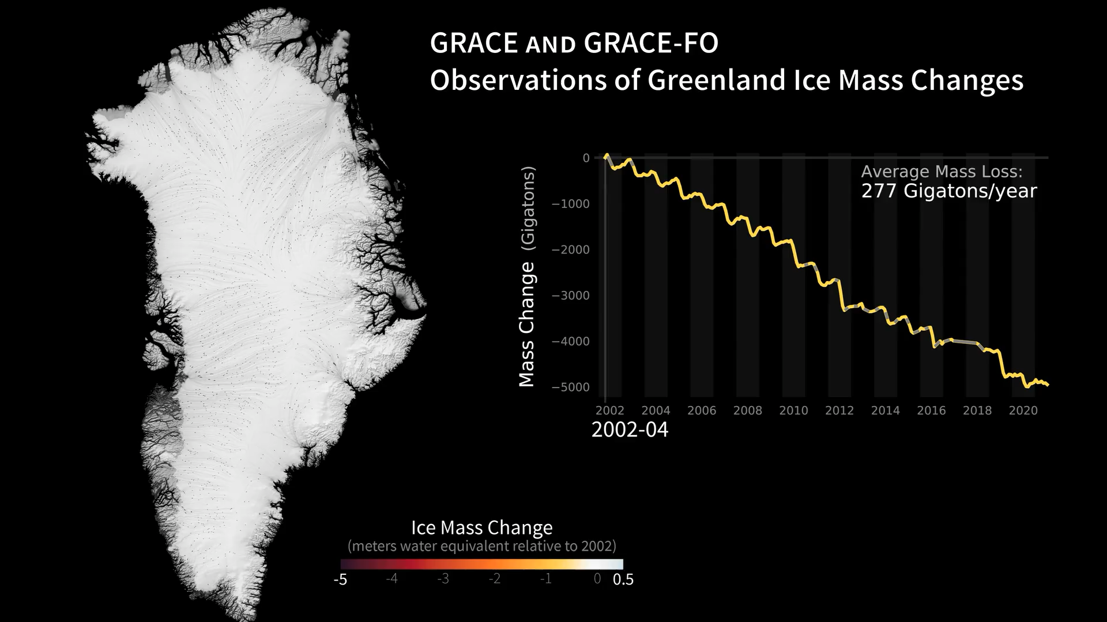
What happens to ocean circulation in the North Atlantic when the Greenland Ice Sheet melts?
M.S. Geosciences
Why is mass loss from the Greenland Ice Sheet concerning from a climate perspective?

Slide 10
What happens to ocean circulation in the North Atlantic when the Greenland Ice Sheet melts?
M.S. Geosciences
7.4 meters of global sea level rise
Why is mass loss from the Greenland Ice Sheet concerning from a climate perspective?

Slide 11
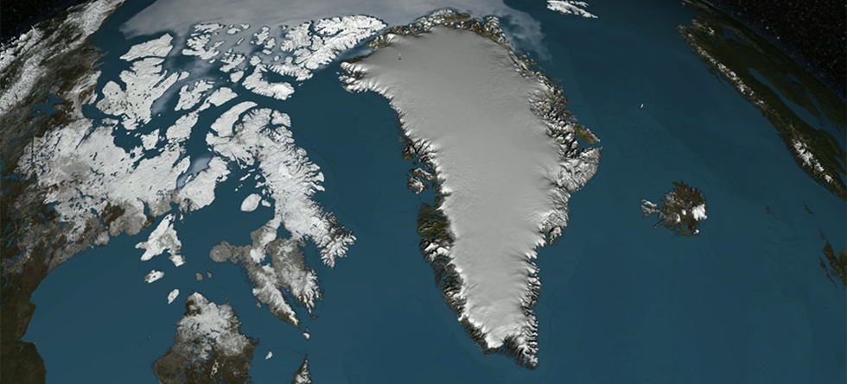
What happens to ocean circulation in the North Atlantic when the Greenland Ice Sheet melts?
M.S. Geosciences
This water
is fresh!
The ocean
is salty!

Slide 12
What happens to ocean circulation in the North Atlantic when the Greenland Ice Sheet melts?
M.S. Geosciences
This water
is fresh!
1000 kg/m³
The ocean
is salty!
~ 1035 kg/m³

Slide 13
What happens to ocean circulation in the North Atlantic when the Greenland Ice Sheet melts?
M.S. Geosciences
This water
is fresh!
1000 kg/m³
The ocean
is salty!
~ 1035 kg/m³
Surface waters lose their heat to the atmosphere, but salt is left behind leading to the formation of
dense waters that sink into the deep ocean

Slide 14
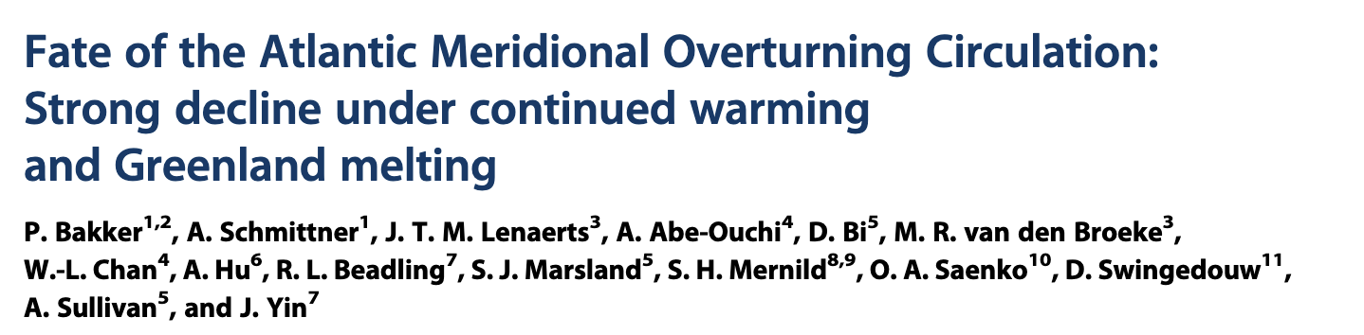
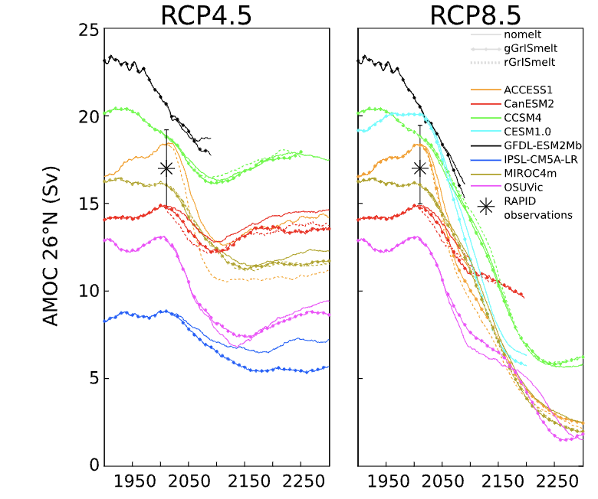
So, I ran some experiments using a climate model to find out.

Slide 15
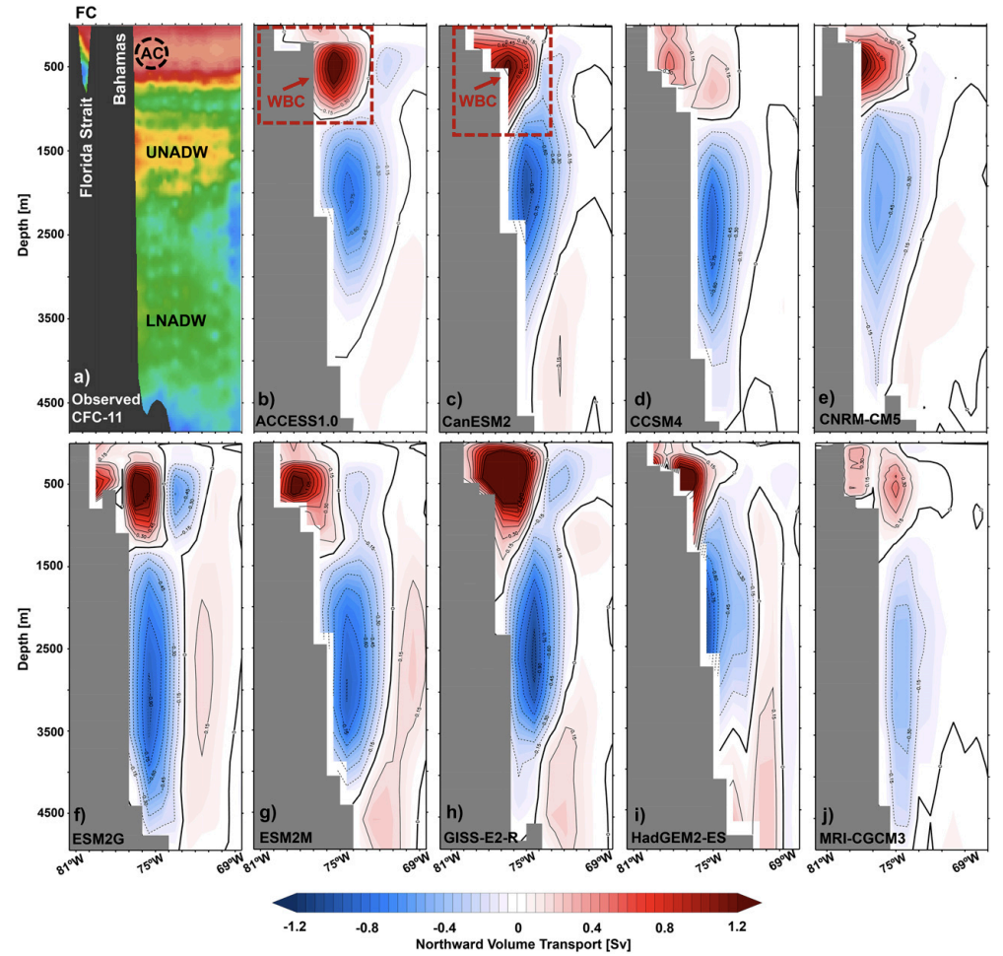
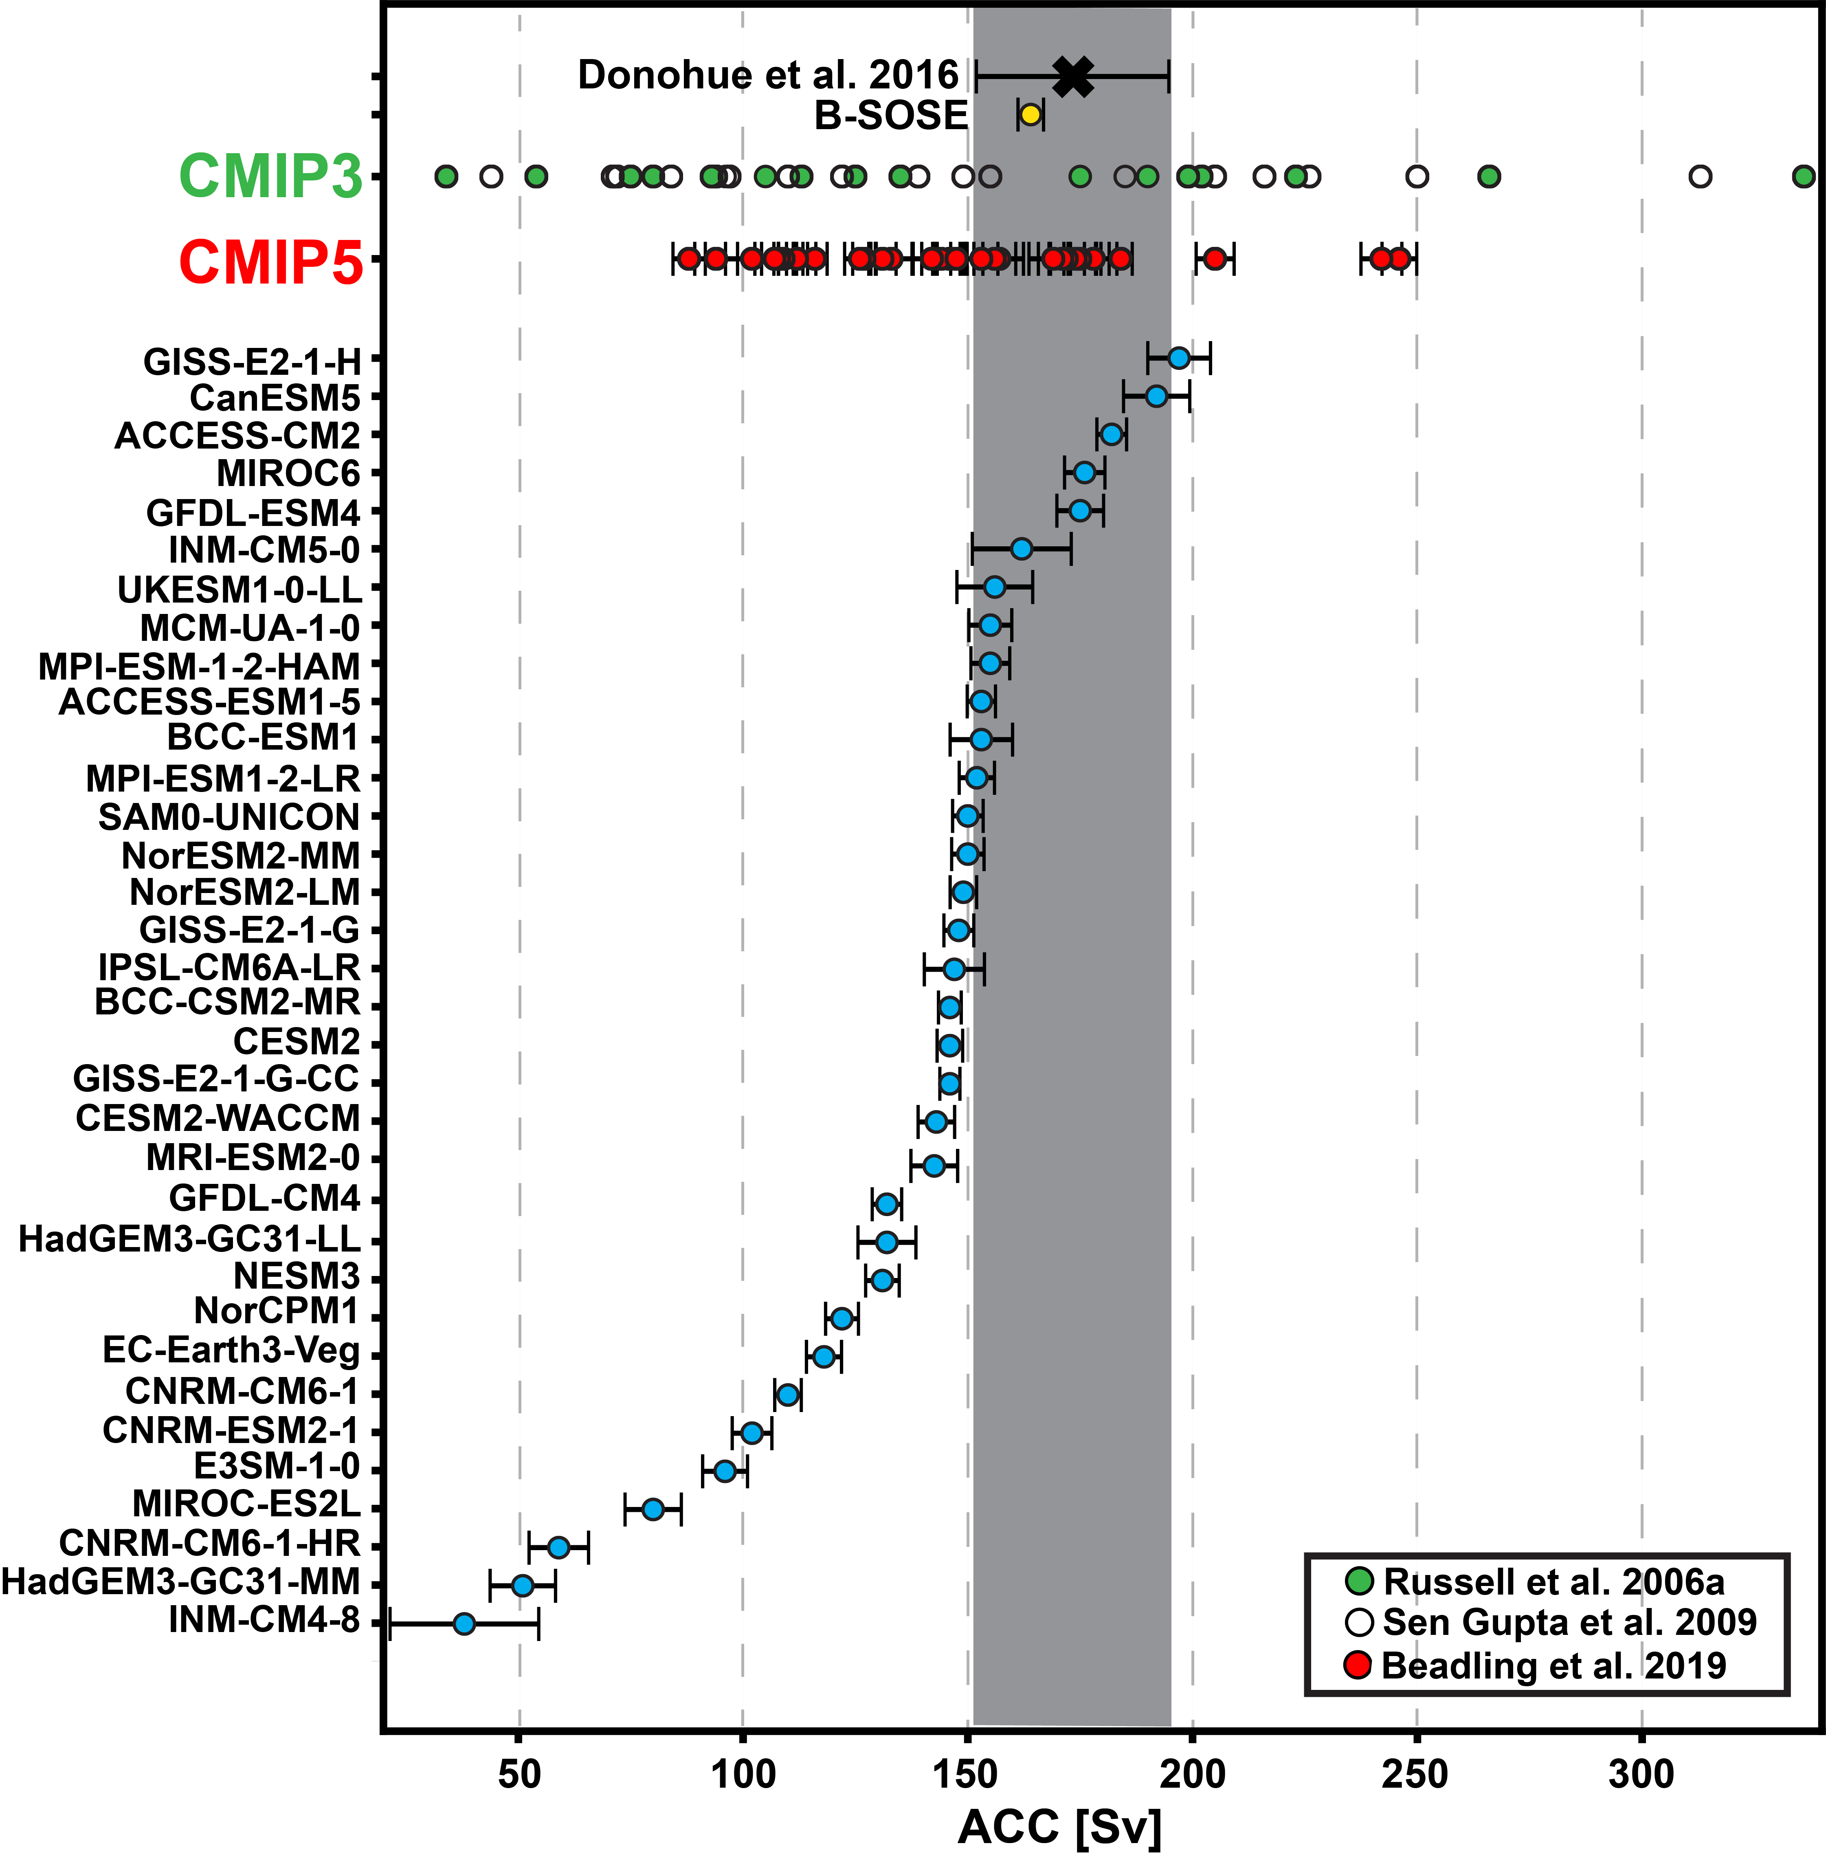
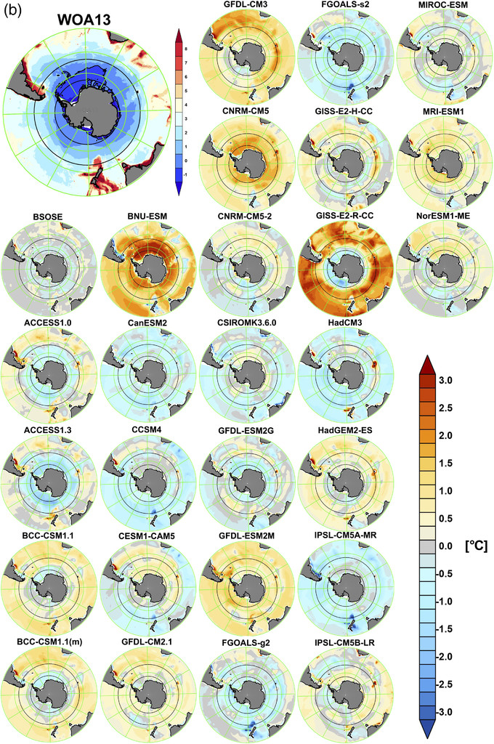
How well do climate models represent ocean circulation and how will ocean circulation change as the climate warms?
Ph.D. Geosciences
Shift towards interest
in the Southern Ocean

Slide 16



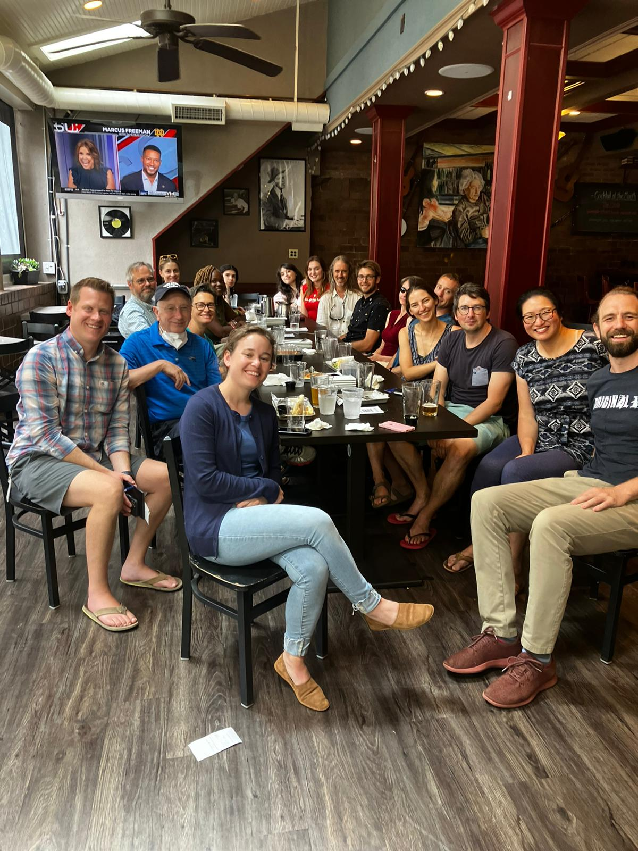
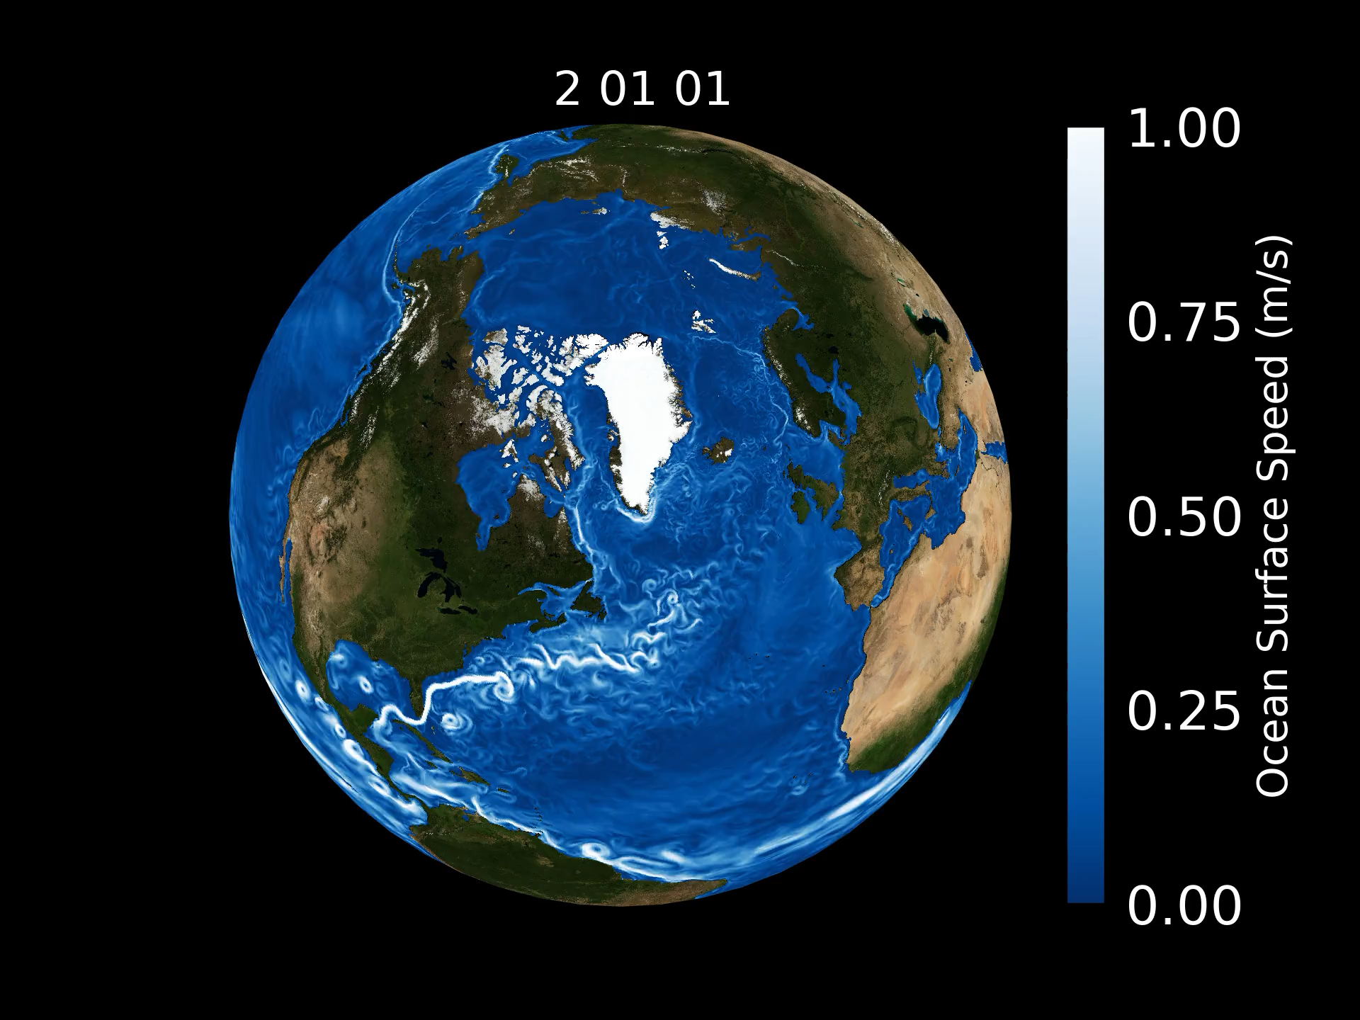
NOAA Climate and Global Change Postdoctoral Fellow at NOAA’s Geophysical Fluid Dynamics Laboratory (GFDL) / Visiting Research Scientist in Princeton’s Atmospheric and Oceanic Sciences program
What happens to the ocean circulation and global climate when the Antarctic Ice Sheet melts and the winds in the Atmosphere change as the climate warms?
Contribute to the development of high-resolution climate model simulations.

Slide 17
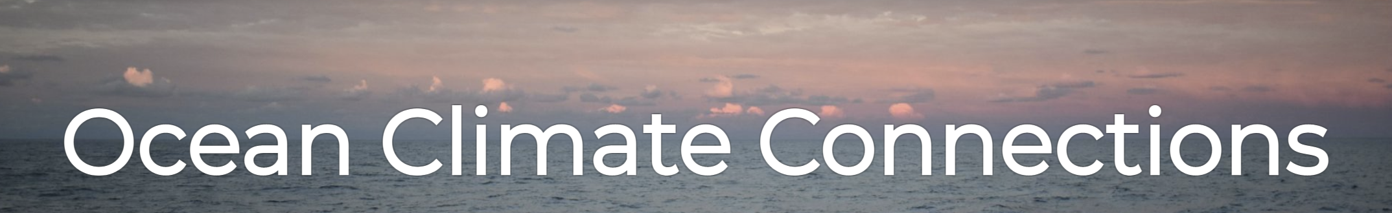



Understanding the ocean’s role in the climate system and climate change
CMIP7 Model Benchmarking Task Team

Slide 18
Understanding the ocean’s role in the climate system and climate change
Understanding model representation of ocean physical and biogeochemical processes
CMIP7 Model Benchmarking Task Team

Slide 19
Understanding the ocean’s role in the climate system and climate change
Understanding model representation of ocean physical and biogeochemical processes
Building analysis frameworks and tools to assess climate models
CMIP7 Model Benchmarking Task Team

Slide 20
Understanding the ocean’s role in the climate system and climate change
Understanding model representation of ocean physical and biogeochemical processes
Building analysis frameworks and tools to assess climate models
Reducing our uncertainty in future climate change through improved physical understanding of the climate system, better models, and better analysis.
CMIP7 Model Benchmarking Task Team

Slide 21
What am I doing when I am not teaching you?
Research
Designing course material
Mentoring
Writing Grant Proposals
Writing, editing, and reviewing manuscripts

Slide 22
What am I doing when I am not teaching you?
Research
Designing course material
Mentoring
Writing Grant Proposals
Writing, editing, and reviewing manuscripts
Hanging out with friends
Enjoying the beer garden / brewery scene around Philadelphia
Never ending house projects
Playing guitar
Spending time outdoors

Slide 23
What tools / datasets do I use in my research / daily workflow ?
Climate model experiment output in the form of NetCDF files, including results from the Coupled Model Intercomparison Project (CMIP)

Slide 24
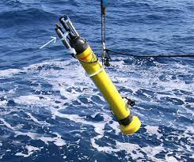
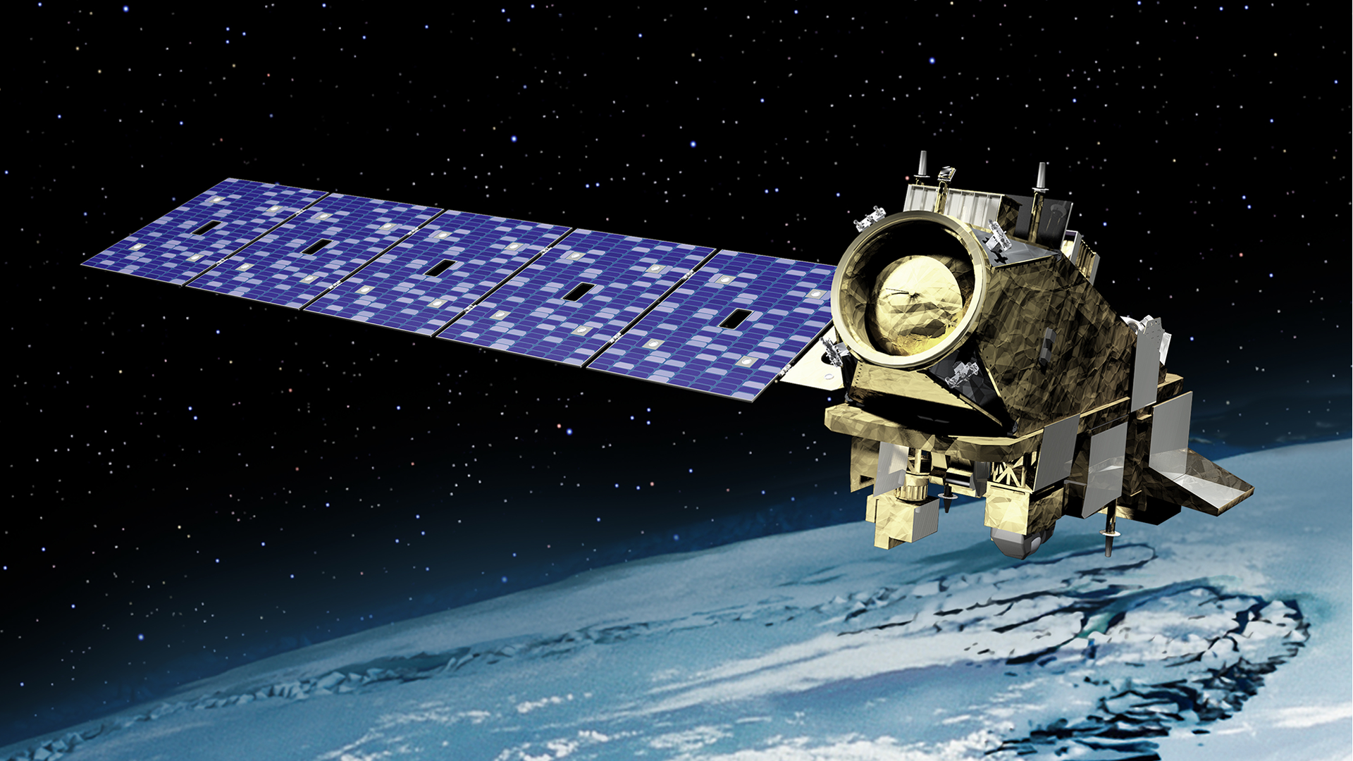
What tools / datasets do I use in my research / daily workflow ?
Climate model experiment output in the form of NetCDF files, including results from the Coupled Model Intercomparison Project (CMIP)
Observational datasets: in-situ data, satellite, gridded-products

Slide 25




What tools / datasets do I use in my research / daily workflow ?
Climate model experiment output in the form of NetCDF files, including results from the Coupled Model Intercomparison Project (CMIP)
Observational datasets: in-situ data, satellite, gridded-products
Open-source Python packages

Slide 26

What tools / datasets do I use in my research / daily workflow ?
Climate model experiment output in the form of NetCDF files, including results from the Coupled Model Intercomparison Project (CMIP)
Observational datasets: in-situ data, satellite, gridded-products
Open-source Python packages
Version control and open reproducible science!

Slide 27

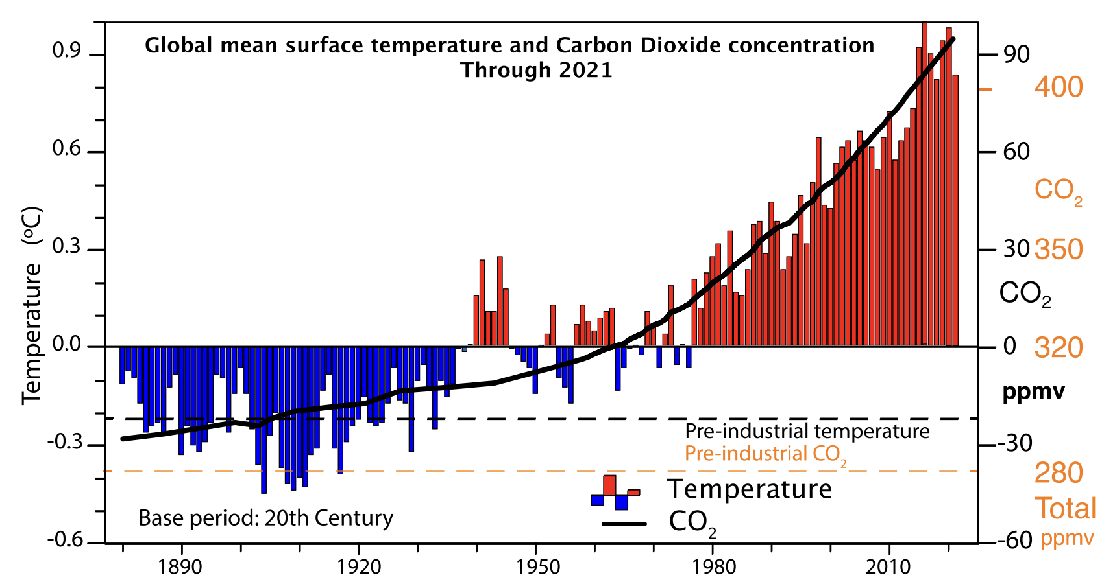
Why do I want to teach this course?
Since the industrial revolution (~1850), human activities have been increasing the concentration of greenhouse gases (CO₂, and others) in Earth’s atmosphere.
These gases act to reduce the outgoing infrared (longwave) radiation and thus create a global energy imbalance, where the Energy coming into the climate system is GREATER than the energy leaving the system (Energy_{in} > Energy_{out}).
As a result, the amount of energy trapped on our planet in the form of heat is increasing.

Slide 28
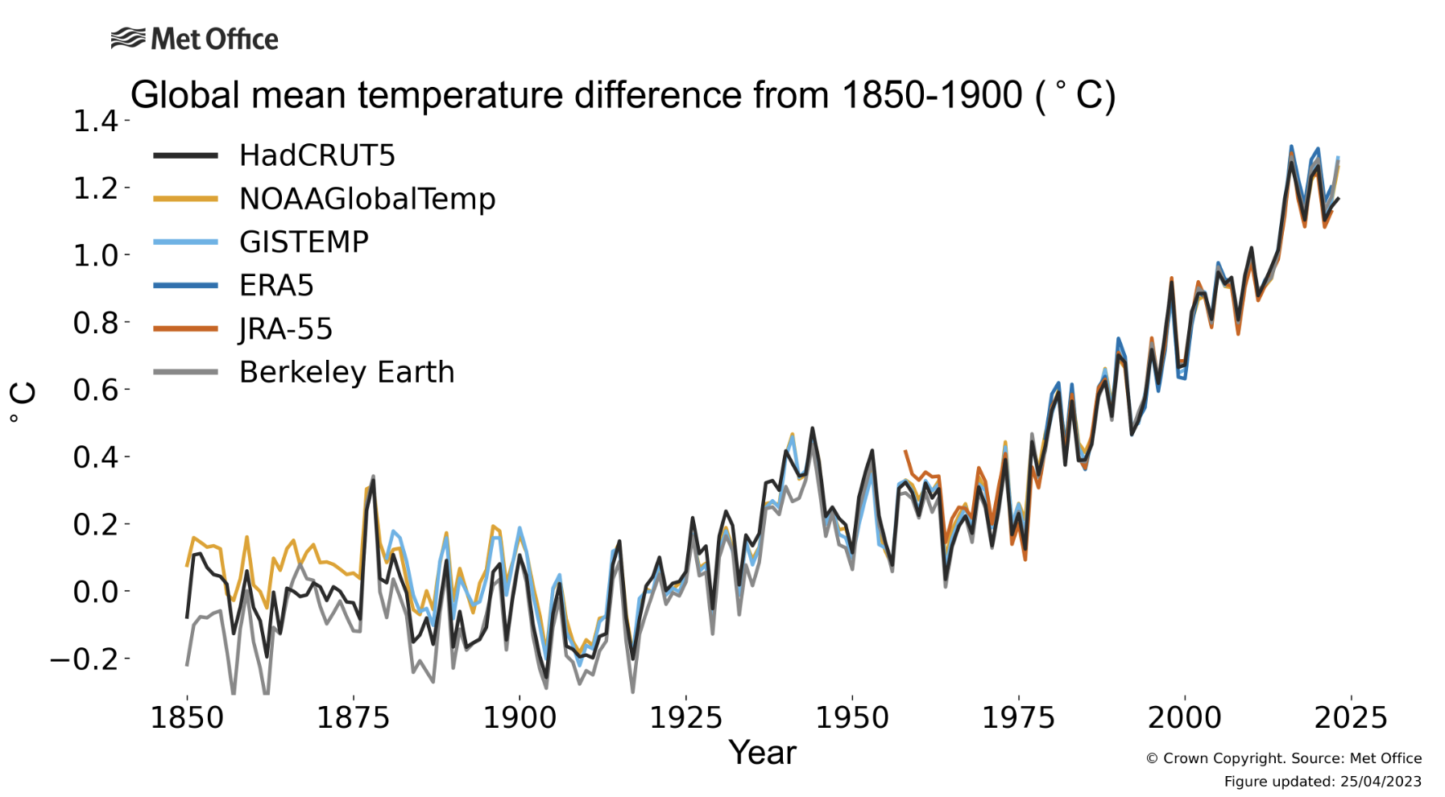

Why do I want to teach this course?
Since the industrial revolution (~1850), we have been experiencing a global energy imbalance, (Energy_{in} > Energy_{out}). As a result, the amount of energy trapped on our planet in the form of heat is increasing.

Slide 29
We know this energy imbalance is due to rising levels of greenhouse gases and that current atmospheric CO₂ concentrations are well outside the range of that experienced over the last …. 323 years
~ 424 ppm
~ 280 ppm

Slide 30
We know this energy imbalance is due to rising levels of greenhouse gases and that current atmospheric CO₂ concentrations are well outside the range of that experienced over the last …. 323 2000 years
~ 424 ppm
~ 280 ppm

Slide 31
We know this energy imbalance is due to rising levels of greenhouse gases and that current atmospheric CO₂ concentrations are well outside the range of that experienced over the last …. 323 2000 10,000 years
~ 424 ppm
~ 280 ppm

Slide 32
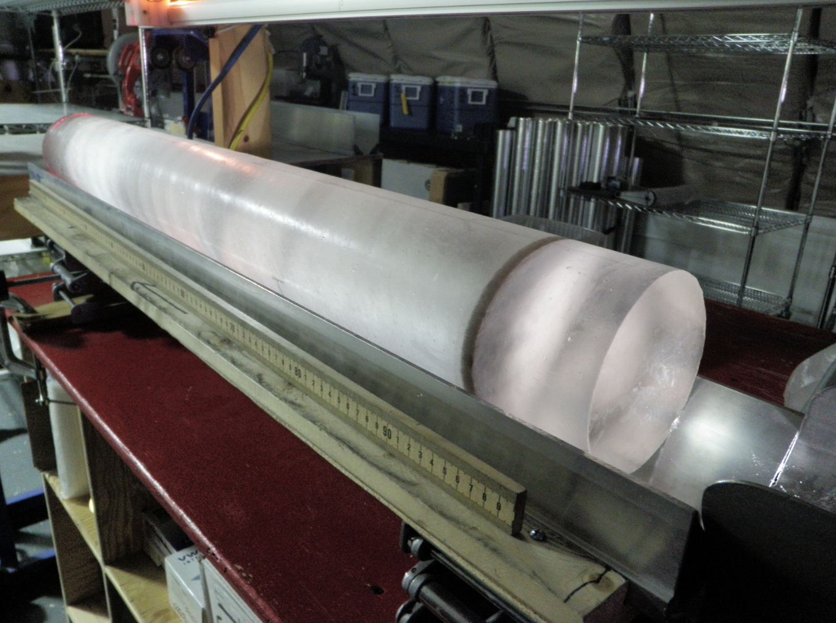
We know this energy imbalance is due to rising levels of greenhouse gases and that current atmospheric CO₂ concentrations are well outside the range of that experienced over the last …. 323 2000 10,000 800,000 years
~ 424 ppm
~ 280 ppm

Slide 33
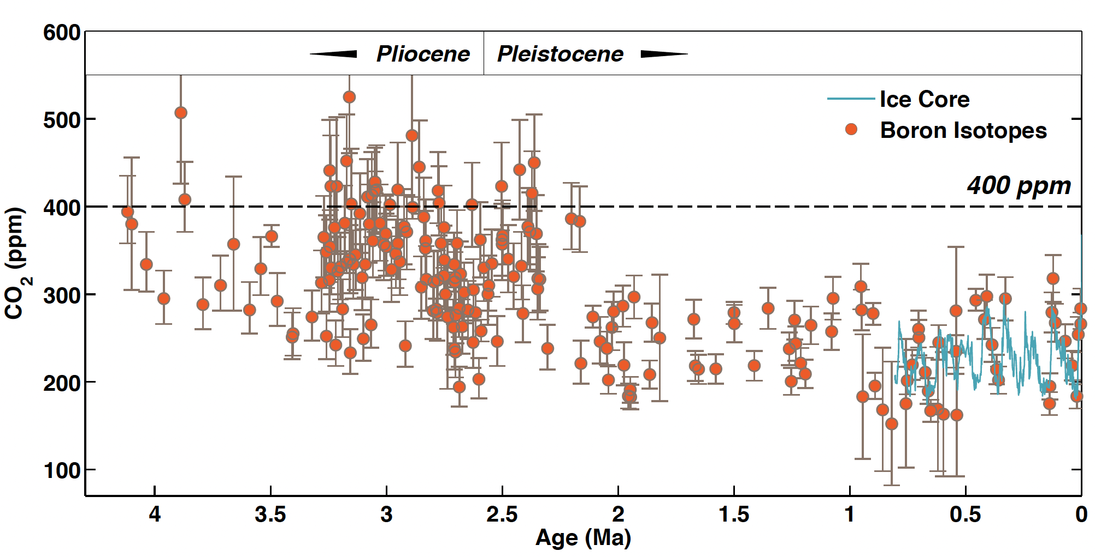
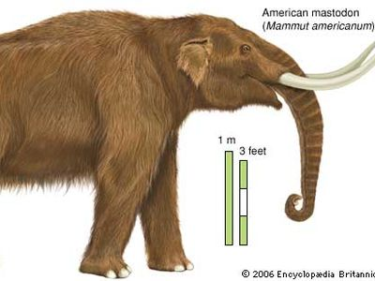
We know this energy imbalance is due to rising levels of greenhouse gases and that current atmospheric CO₂ concentrations are well outside the range of that experienced over the last …. 323 2000 10,000 800,000, 2.5 to 5 million years !!
Figure by Jessica Tierney, UA
Glacial – interglacial cycles
homo sapiens

Slide 34
This excess heat is rapidly transforming our climate system, impacting ecosystems and society.
There is a clear and urgent need to:
understand what is happening to the climate system
what’s in store for the future
develop adaptation and mitigation strategies

Slide 35
This excess heat is rapidly transforming our climate system, impacting ecosystems and society.
data & models
There is a clear and urgent need to:
understand what is happening to the climate system
what’s in store for the future
develop adaptation and mitigation strategies
Relies on the effective communication of information from derived from
data & models.

Slide 36
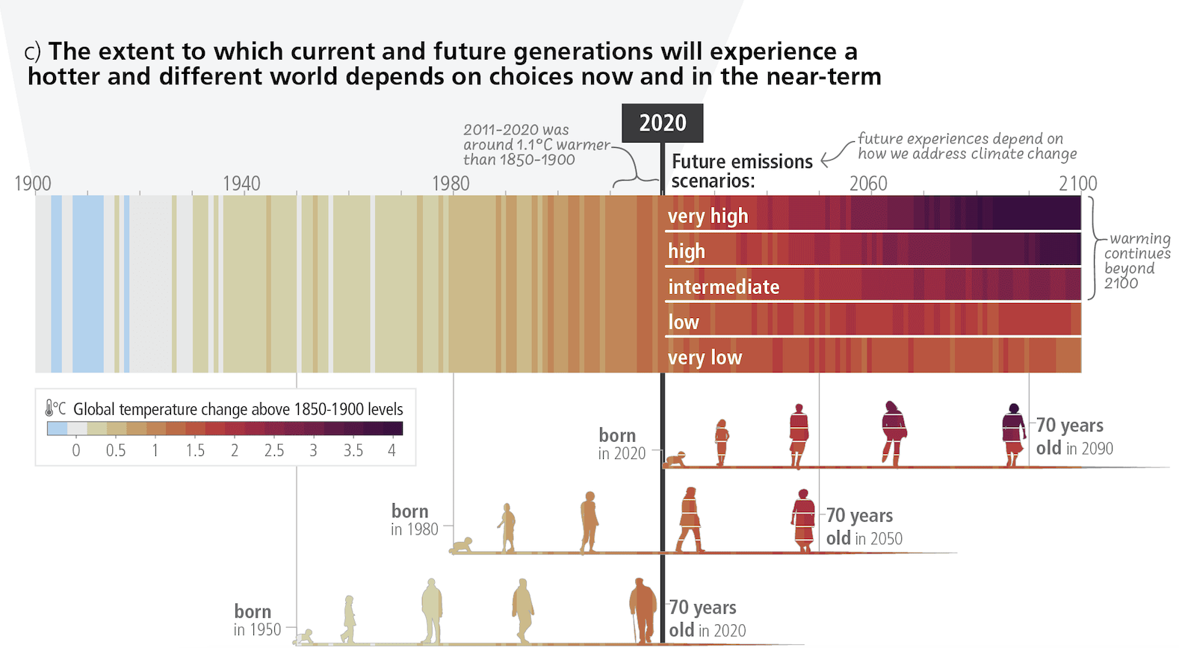
We need people who understand the climate system and environment, have the skillsets to analyze data, and effectively communicate results.
IPCC AR6

Slide 37

EES 3506 / 5506 Observing & Modeling Climate Change
Fall 2023 Goals
Gain experience in the tools that scientists use to analyze observational datasets and climate model output.

Slide 38
EES 3506 / 5506 Observing & Modeling Climate Change
Fall 2023 Goals
Gain experience in the tools that scientists use to analyze observational datasets and climate model output.
Explore the direct evidence of anthropogenic climate change through active analysis of real-world datasets using the Python programming language.

Slide 39
EES 3506 / 5506 Observing & Modeling Climate Change
Fall 2023 Goals
Gain experience in the tools that scientists use to analyze observational datasets and climate model output.
Explore the direct evidence of anthropogenic climate change through active analysis of real-world datasets using the Python programming language.
Gain an introductory level understanding of what climate models are and how to analyze the results of climate modeling experiments to explore 21st century climate projections.

Slide 40

Course Objectives (what you should be able to do by the end …)
Use the Command Line Interface (CLI) to interact with a computer including navigating and creating directories and running programs.
Use a Command Line editor to create and edit text files on a computer.
Have an understanding of the utility of Git and GitHub as version control tools and be able to incorporate these tools into your workflow.
Understand the basic workflow of working inside a Jupyter Notebook – from importing Python packages, reading in datasets, performing calculations, creating descriptive Markdown, to creating and saving figures.
Be familiar with basics of Python and the Numpy, Xarray, Matplotlib, and Cartopy Python packages.
Create effective visualizations and quantitative summaries of data from 1-Dimensional timeseries to 4-D oceanic and atmospheric time evolving datasets.
Communicate the evidence of anthropogenic climate change through data, describe data sources and collection methods, and communicate levels of uncertainty.
•

Slide 41
Syllabus / Course Highlights
Lecture: Tuesday & Thursday BEURY 304, 9:30 am – 10:50 am

Slide 42
Syllabus / Course Highlights
Lecture: Tuesday & Thursday BEURY 304, 9:30 am – 10:50 am
You are expected to show up on time and immediately startup and log into your Virtual Machine (VM).

Slide 43
Syllabus / Course Highlights
Lecture: Tuesday & Thursday BEURY 304, 9:30 am – 10:50 am
You are expected to show up on time and immediately startup and log into your Virtual Machine (VM).
You are expected to always stay on-task and participate (i.e., no checking emails, etc. while in the computer lab … I know it is tempting to get off task when a computer is in front of you).

Slide 44
Syllabus / Course Highlights
Lecture: Tuesday & Thursday BEURY 304, 9:30 am – 10:50 am
You are expected to show up on time and immediately startup and log into your Virtual Machine (VM).
You are expected to always stay on-task and participate (i.e., no checking emails, etc. while in the computer lab … I know it is tempting to get off task when a computer is in front of you).
Do not waste your time, and do not waste my time:
Life is way too short to waste time, recognize this.
You will get out of this course what you put into it:
If you give it the bare minimum … you will walk away with the bare minimum.
It is rare in life where you are given the opportunity to learn and have the resources to do so. Once you’re out on the job market, no one is training you!
Take yourself and your work seriously, strive for a higher standard.

Slide 45
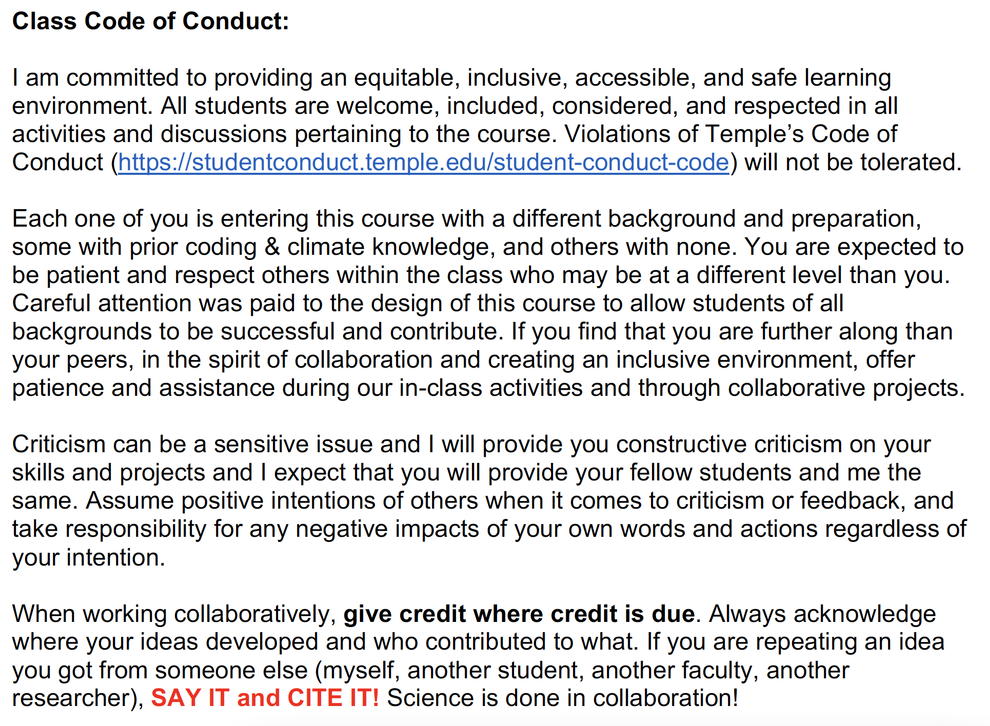



Code of Conduct

Slide 46
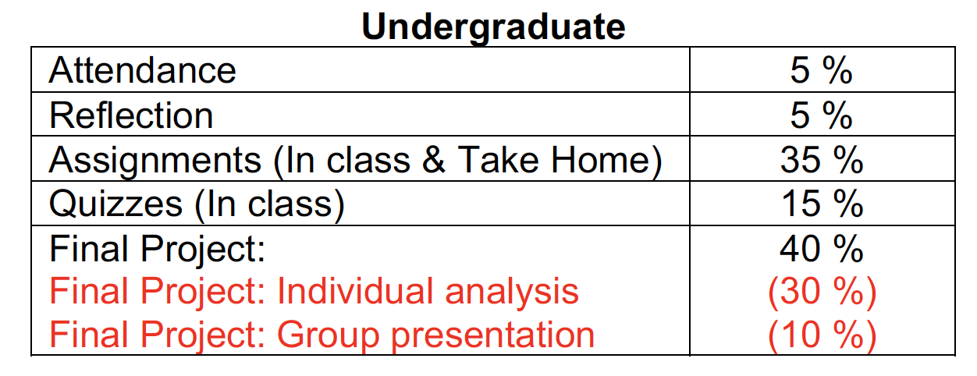
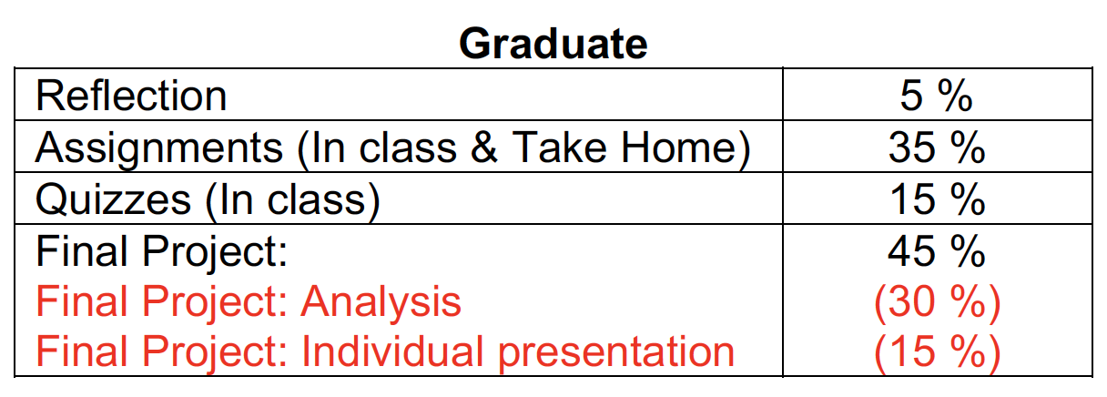
Grading
There will be no exams in this course! Your final grade will come from a combination of attendance, in-class quizzes (announced), assignments, and your final class project.

Slide 47
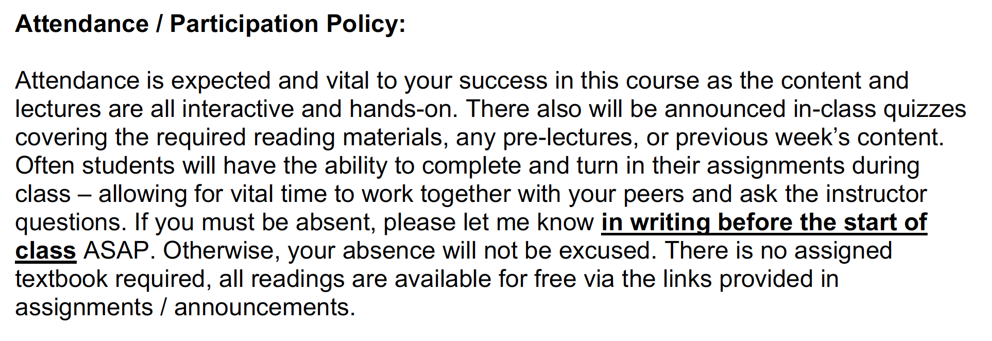
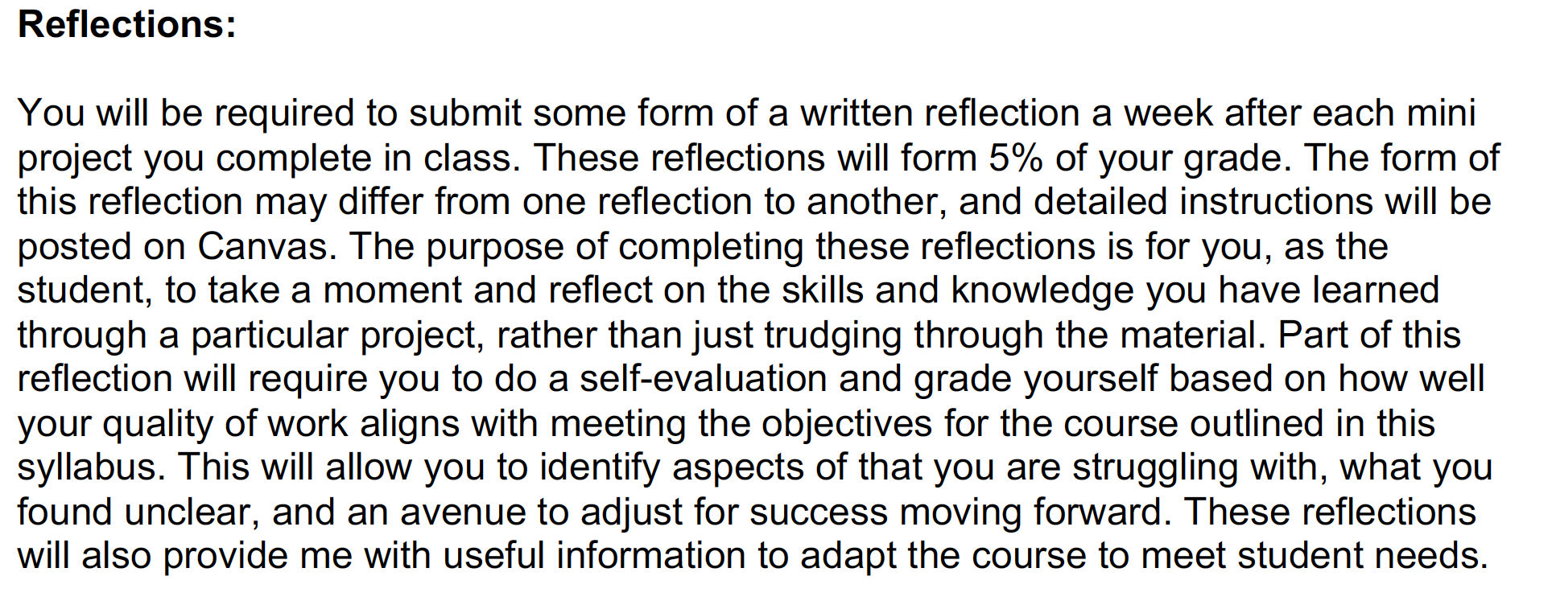






Slide 48
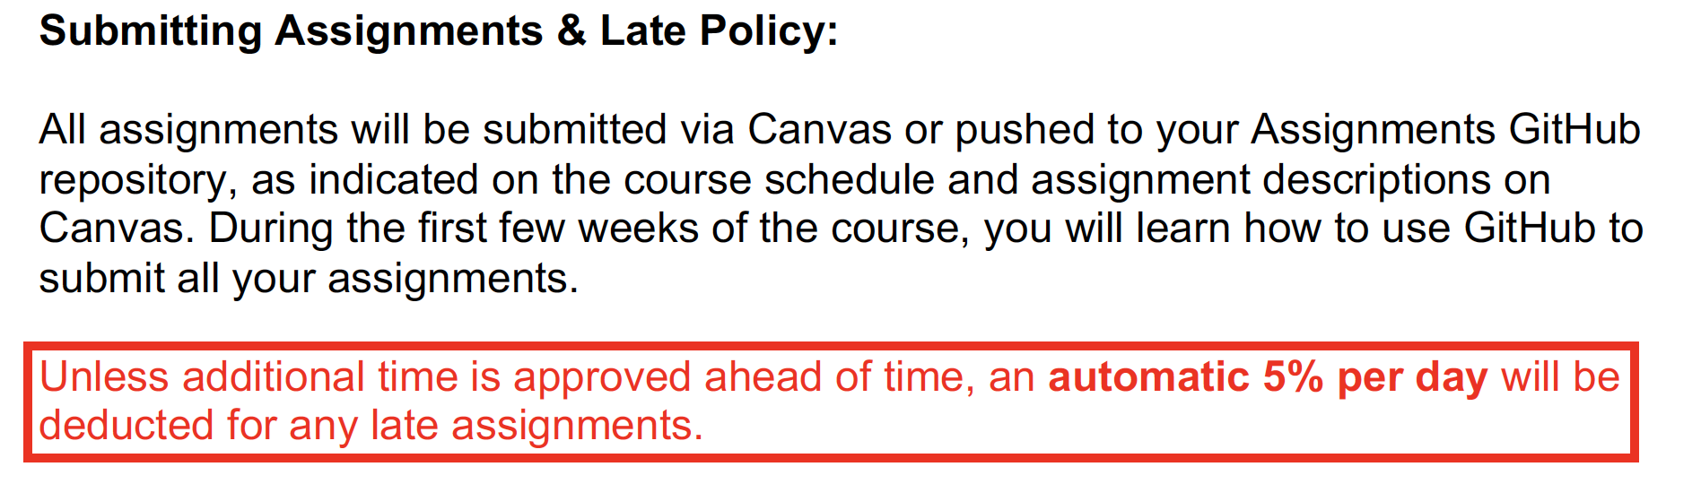
Submitting Assignments, Late Policy, and Assigned Reading
Submissions will occur via Canvas or GitHub, as indicated in the instructions of each assignment.
Assigned reading is expected to be completed prior to class.

Slide 49
Our Course Ingredients
Readings: to provide introduction to material / tools that we will be using in class. All readings should be done prior to that class period.
Daily / Weekly in-class assignments: Assignments that need to be pushed to GitHub at the end of each class or by the designated due date. Class time will be given for completing assignments, but more comprehensive assignments may require finishing outside of class.
Mini-projects: Comprehensive projects designed for development of skills and knowledge introduced in previous lessons / lectures. Each mini-project will have full in-class working days followed by a de-brief and volunteer mini-presentation of results.
Science Lecture Days: In-class lectures on a specific aspect of the climate system and climate change. These are designed to provide critical background knowledge for your mini-projects.
Final Project …… last ~4 weeks of class, > 40 % of grade.

Slide 50
Final Project …… last ~4 weeks of class, > 40 % of grade.
Scroll down to the bottom of your syllabus for more details …..
Apply your skills and knowledge developed in the first ~10 weeks of the course to investigate a particular aspect of the climate system and its projected change throughout the 21st century.
Utilize observational datasets and climate model projections.
Undergraduates: Groups of 3, Graduate: Individual Analysis.
Theme and groups will be assigned in the week prior to start of project.
Dedicated in-class working days with check-ins with Dr. Beadling on progress.
Each individual is tasked with producing interactive and descriptive analysis through Jupyter Notebooks that must be fully reproducible.
Results will be brought together for a final poster presentation for undergraduate students, final oral presentation for graduate students.

Slide 51
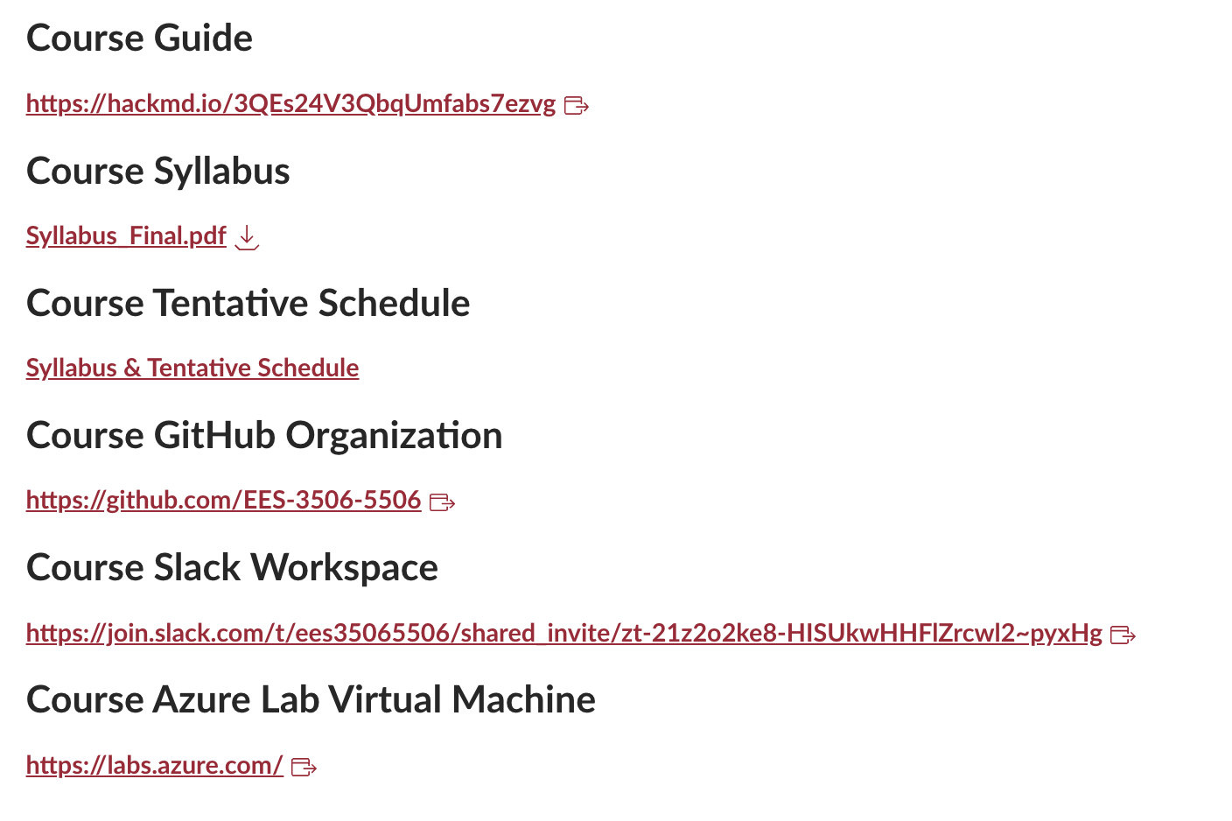
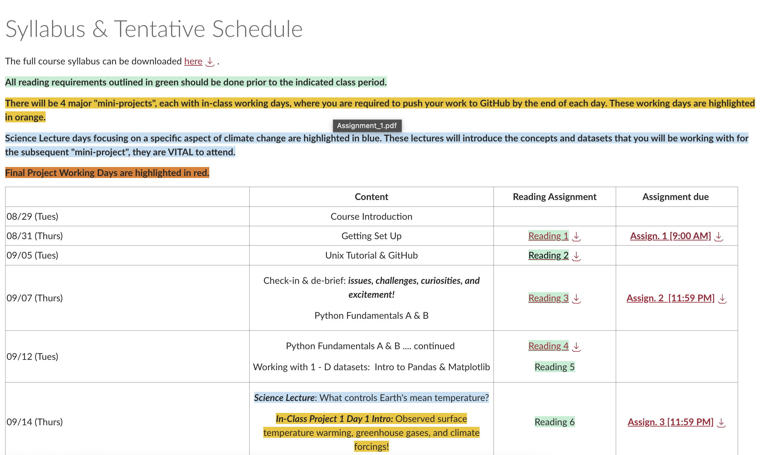
Bottom of Canvas homepage

Slide 52
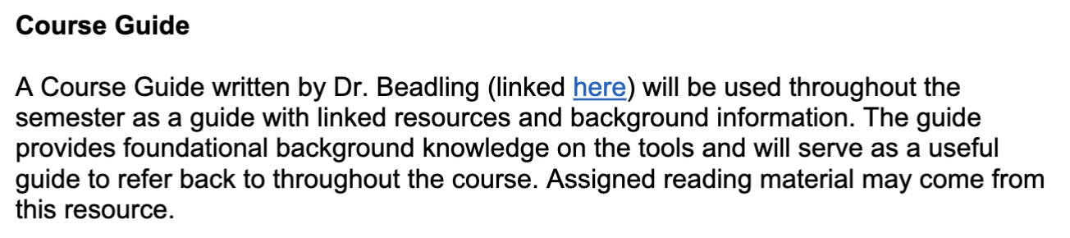
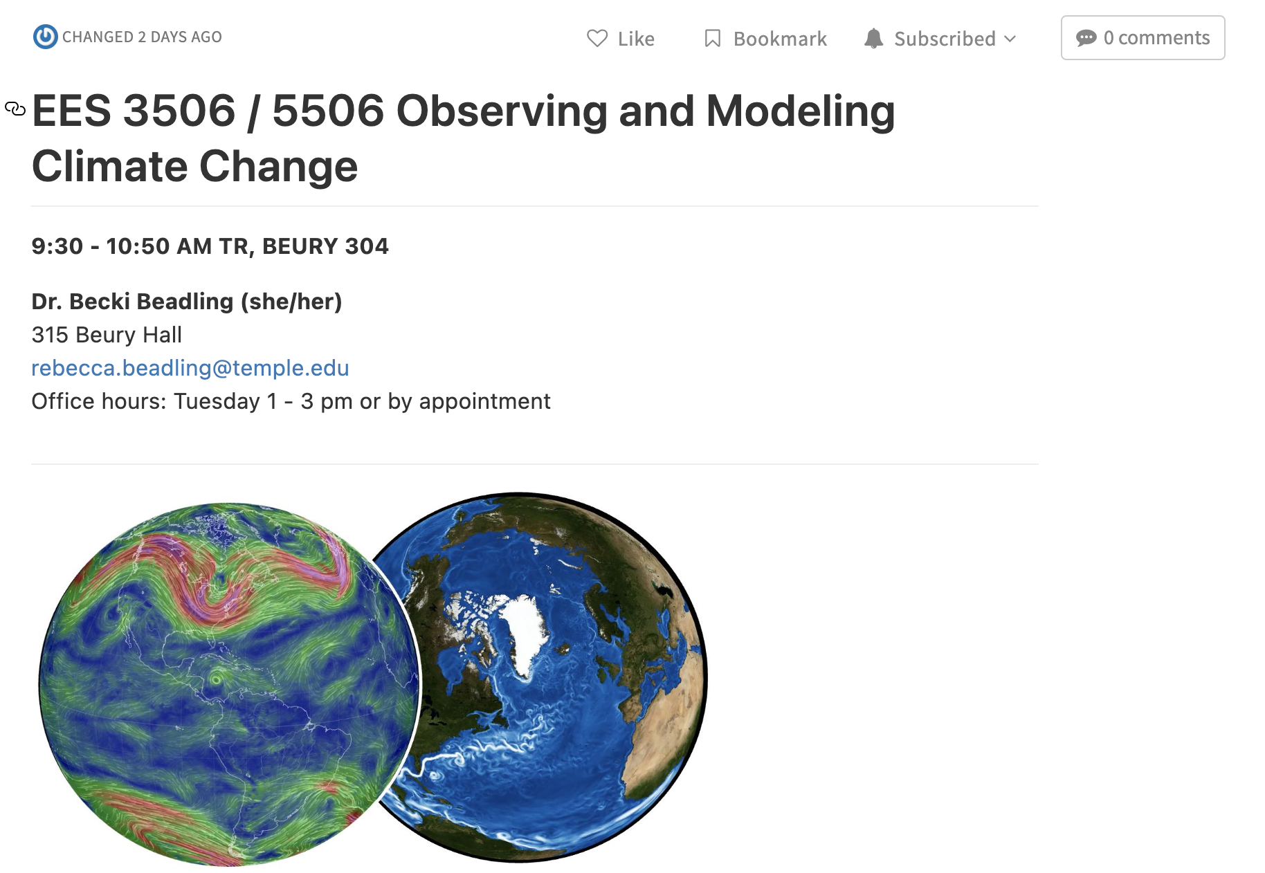
Course Resources

Slide 53
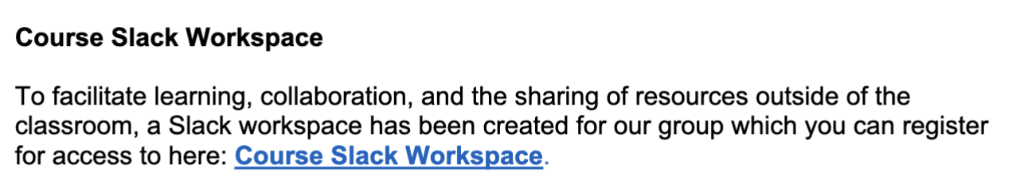

Course Resources

Slide 54
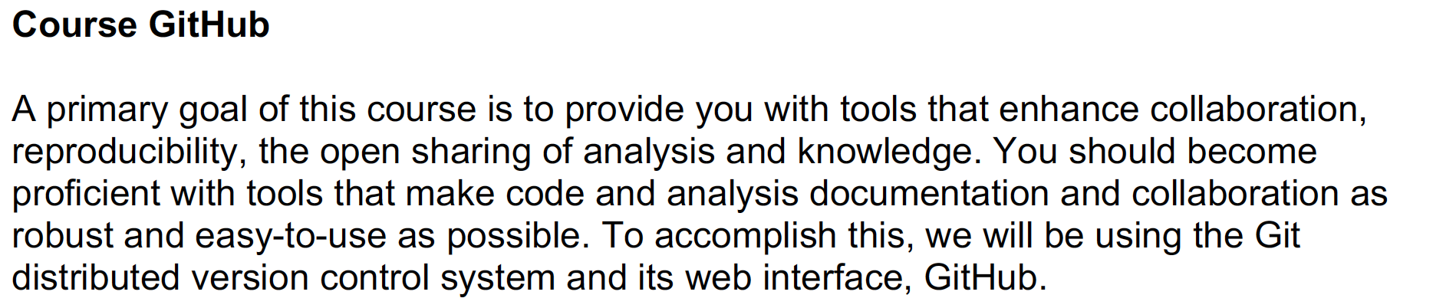
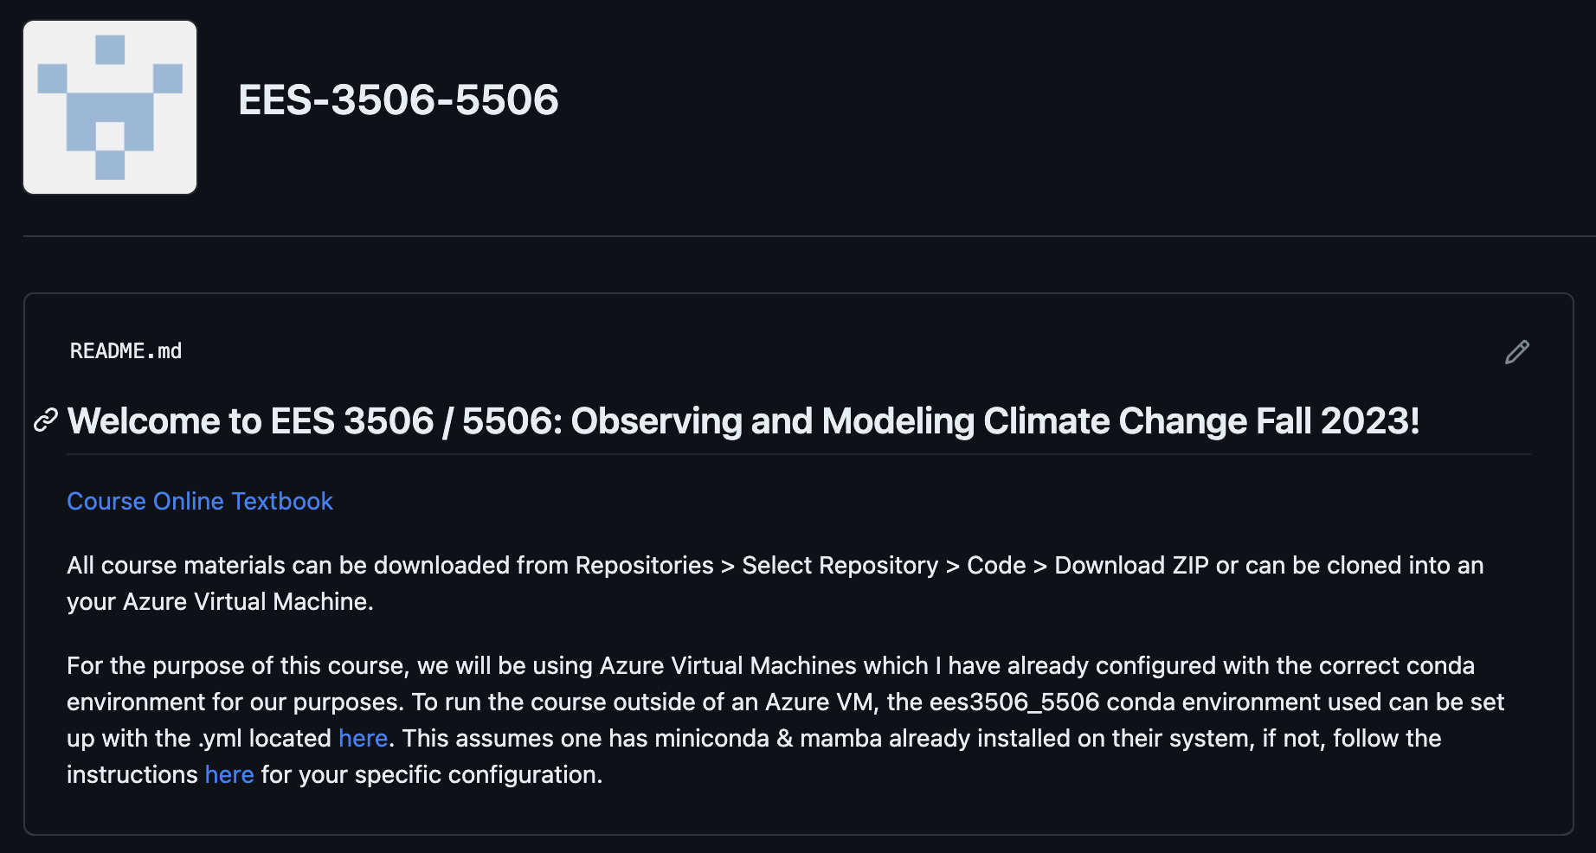
Course Resources

Slide 55


Course Resources
Course Virtual Machines
In this course we will be using the Microsoft Azure cloud computing platform for all our computing and data storage needs. Each student will be assigned a unique Azure Labs Virtual Machine (VM). It takes a few minutes to spin up your
VM each time you log in, so it is imperative that you show up to class on time and login immediately to ensure you are ready to go.

Slide 56
We will be using the Microsoft Azure cloud computing platform for all our computing and data storage needs.
Each day we will be logging onto a custom virtual machine hosted “in the cloud”, a.k.a at a large, globally connected, datacenter … which we access over the internet (the cloud).

Slide 57

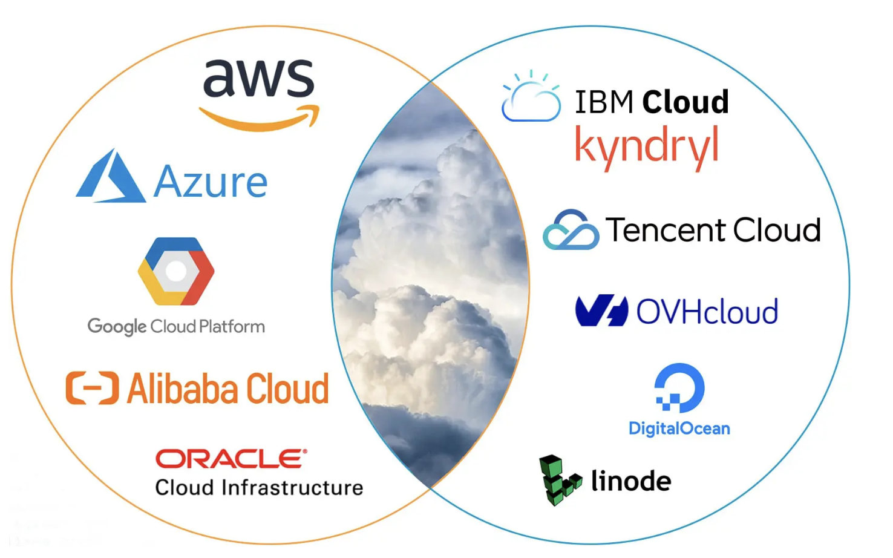

Slide 59


Slide 61


Slide 63


Slide 65


Slide 67


Slide 69
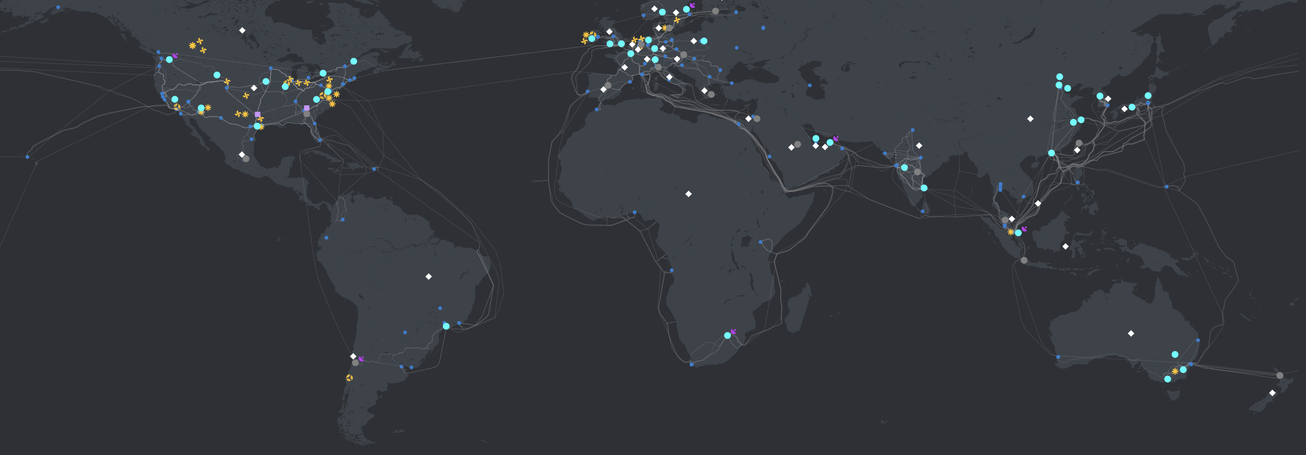
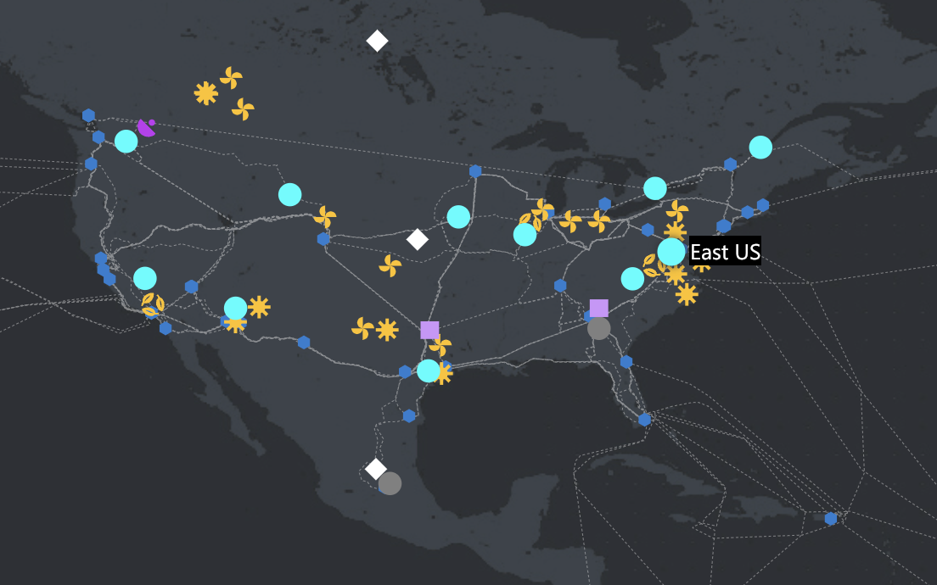
Each day we will be logging onto a custom virtual machine hosted “in the cloud”, a.k.a at a large, globally connected, datacenter … which we access over the internet (the cloud).
Azure East in Virginia
https://datacenters.microsoft.com/globe/

Slide 70
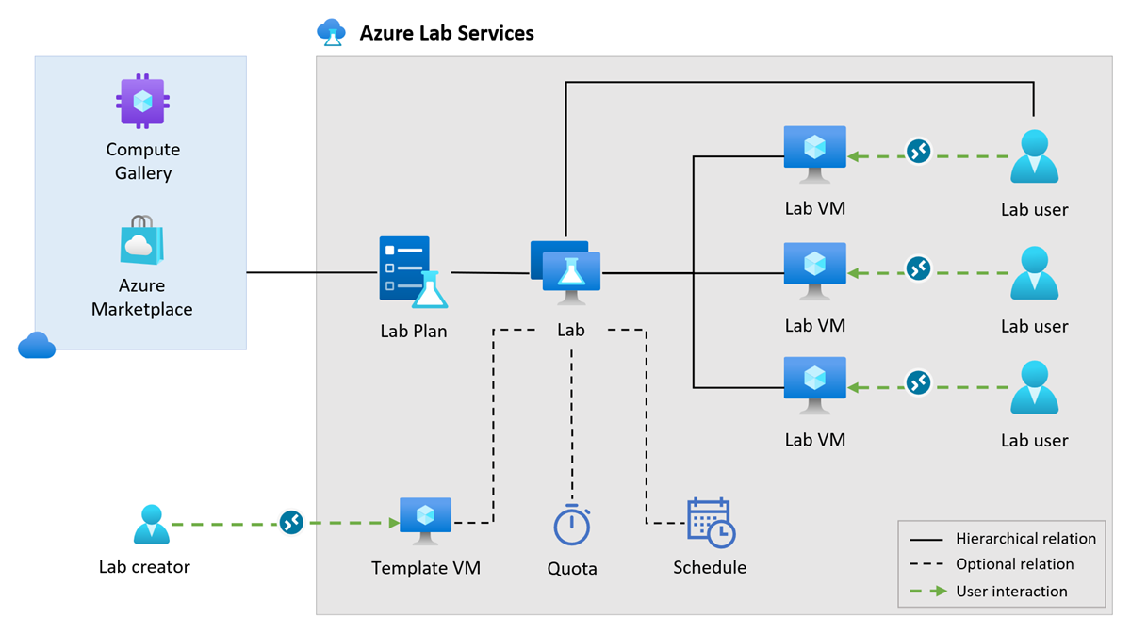
Specifically, we are using Azure Lab Services to deploy this course. Each of you are assigned an individual Virtual Machine (VM) hosted at Azure’s US East 2 location.

Slide 71
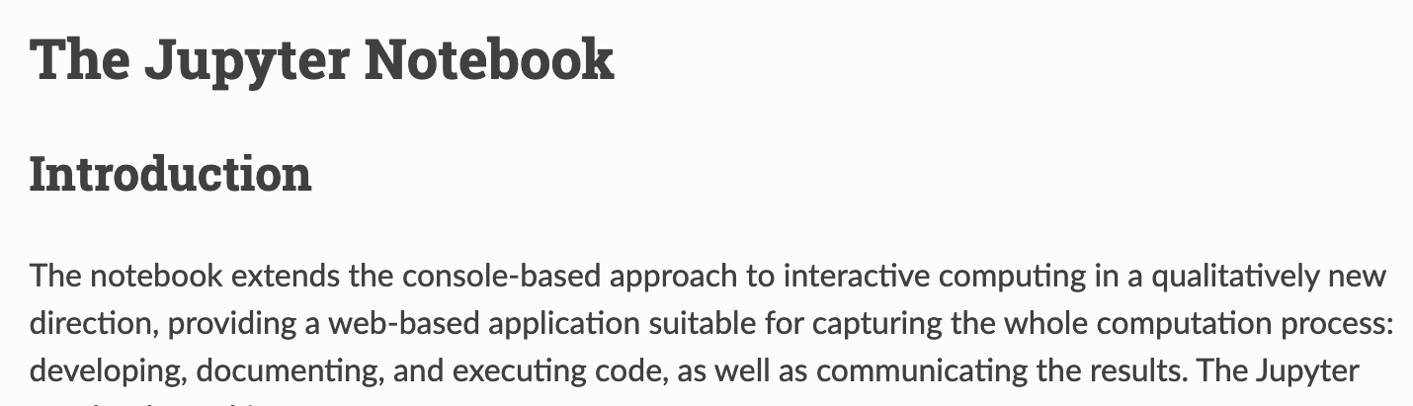





This course will rely heavily on the use of Python within Jupyter Notebooks for interactive computing and communicating results.
https://jupyter-notebook.readthedocs.io/en/stable/notebook.html

Slide 72

This course will rely heavily on the use of Python within Jupyter Notebooks for interactive computing and communicating results.
Develop code
Run code
Visualize output
add text explanations, formulas, images, weblinks, etc.
https://jupyter-notebook.readthedocs.io/en/stable/notebook.html

Slide 73
Okay, lets get set up.
Following along with the instructions for logging into your Azure VM in our Course Guide: https://hackmd.io/3QEs24V3QbqUmfabs7ezvg?view#Cloud-Computing-with-Microsoft-Azure
Accept your registration for a VM via the invite that was sent to you from azure-noreply@microsoft.com.
Navigate to your unique VM, click the toggle on the left side if your VM is not running, and click the computer widget to get the log in information.
Open up a terminal window on your computer:
Windows: search for “command prompt” in your programs
Mac: search for “terminal window”
Copy and paste the entire ssh command into your terminal window and click enter …
When prompted for a password enter Climate2023.

Slide 74
Okay, lets get set up.
Log out of your VM by typing “logout” at the command line and repeat the steps we just went through to re-connect, including using the Azure VM link on our Canvas homepage to navigate to your VM.
Do this several times until you feel comfortable with the login process.
Is anyone having any issues ????

Slide 75
Okay, lets get set up.
Log out of your VM by typing “logout” at the command line and repeat the steps we just went through to re-connect, including using the Azure VM link on our Canvas homepage to navigate to your VM.
Do this several times until you feel comfortable with the login process.
Is anyone having any issues ????
Quotas: Each user will have a certain number of ”compute hours” that they can use to complete assignments outside of class. This will be adjusted throughout the semester depending on assignments / project needs. You need to be careful not to waste your compute hours, i.e., only use your VM for class work, exploring, & reviewing content related to the course. To avoid accidently wasting compute time, you must log out of your VM when done using it. By default, if it is idle for 15 minutes it will automatically log you out.

Slide 76
Okay, lets get set up: Testing Jupyter Lab launch
After logging in, type the following: conda activate ees3506_5506
Then type: gojupyter. This will launch several lines, at the bottom of which are urls.
Open up a NEW terminal window and copy and paste the following and enter your Climate2023 password when prompted: ssh -p PUT_YOUR_UNIQUE_PORT_NUMBER_HERE -L 8088:localhost:8088 ees_student@lab-99a4437a-c549-4f0e-9bc1-d4962d2ddd90.eastus2.cloudapp.azure.com.
Now copy and paste one of the generated urls into your webbrowser, this should open up an instance of Jupyter Lab.
Is anyone having any issues ????

Slide 77
How to succeed in this course
Attend lectures, take good notes, learn interactively through the guided Jupyter Notebooks!
Read assigned material on time, write down any questions you have during the process!
Turn in your assignments on time - A zero is a very powerful way to hurt your grade!
Participate in all activities, discussions, and reviews. Participation comes in many forms and we all may feel comfortable participating in a different way – find what works for you. The important part is that you are interacting with the material.
Schedule office hours with me to talk through any material or concepts you are struggling with. Let me know how I can help you.
Use your quota hours to explore outside of class, a lot of learning happens through just messing around. Do not just do the bare minimum.

Slide 78
Most importantly …….
Take care of yourself! College is overwhelming and you will most likely experience anxiety in some form at some point. Anxiety manifests itself in many ways.
I too have anxiety and stress and deadline lines and feel overwhelmed. Not too long ago, I was also a student. It is okay not to know the right answer! That is the purpose of science – to build an understanding of things you do not understand! Admit you don’t know and dig into the resources available to understand (including me!).
My goal is for each of you to learn and to create an environment where you can do so. Please use the student feedback form or email me with any suggestions or concerns throughout the semester. Reach out when a problem arises – not before missed assignments start racking up!

Slide 79
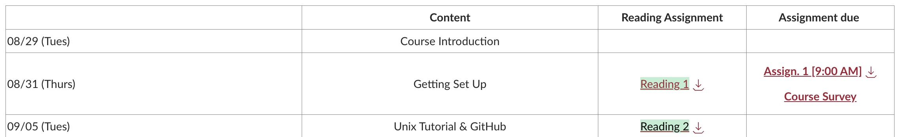
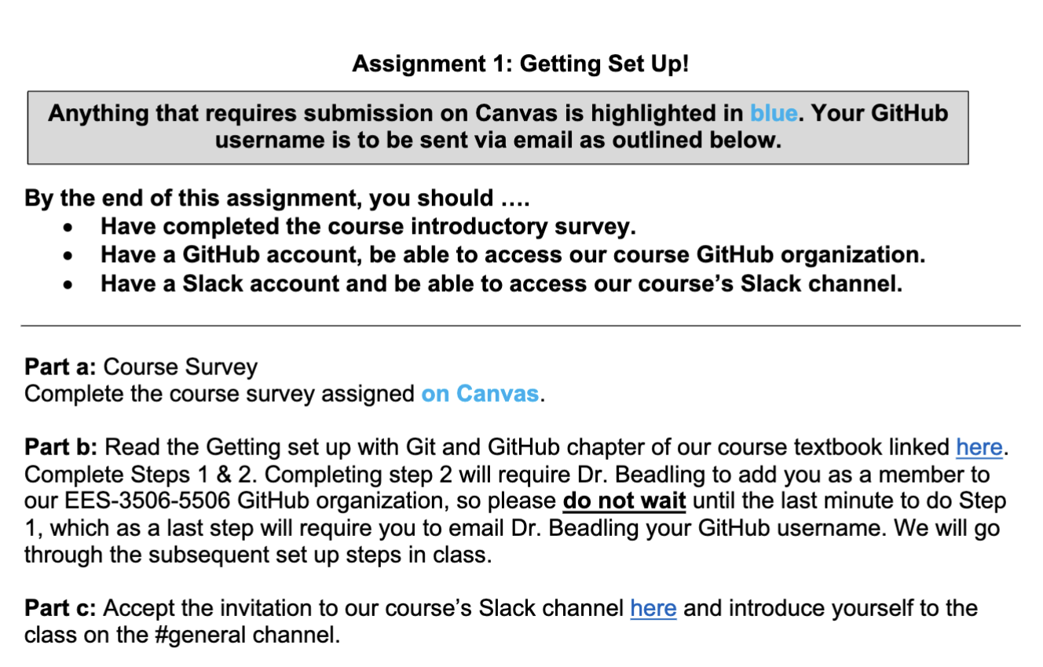
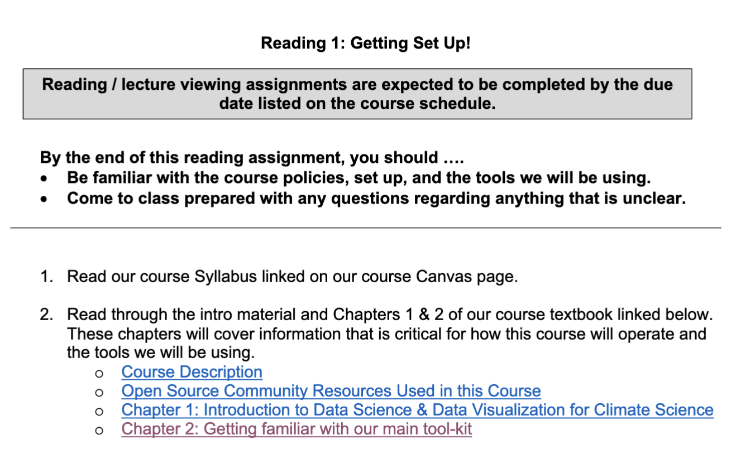
To do:
Log on to the Canvas site if you have not done so already! Become familiar with where to find the syllabus, schedule, and course resources.
Complete Reading1 and Assignment 1.

Slide 80
Up Next:
Getting set up with Git & GitHub, Intro to Unix

